Slide 1

Elijah & Elisha
Our Living Foundations.com

Slide 2

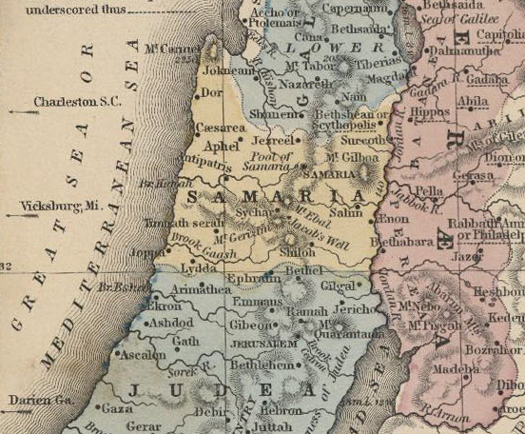
Elijah & Elisha

Slide 3
2nd Kings 2
2Ki 2:1-7 And it came to pass, when the LORD would take up Elijah into heaven by a whirlwind, that Elijah went with Elisha from Gilgal. (2) And Elijah said unto Elisha, Tarry here, I pray thee; for the LORD hath sent me to Bethel. And Elisha said unto him, As the LORD liveth, and as thy soul liveth, I will not leave thee. So they went down to Bethel.

Slide 4
2nd Kings 2
2Ki 2:1-7 (3) And the sons of the prophets that were at Bethel came forth to Elisha, and said unto him, Knowest thou that the LORD will take away thy master from thy head to day? And he said, Yea, I know it; hold ye your peace. (4) And Elijah said unto him, Elisha, tarry here, I pray thee; for the LORD hath sent me to Jericho. And he said, As the LORD liveth, and as thy soul liveth, I will not leave thee. So they came to Jericho.

Slide 5
2nd Kings 2
2Ki 2:1-7 (5) And the sons of the prophets that were at Jericho came to Elisha, and said unto him, Knowest thou that the LORD will take away thy master from thy head to day? And he answered, Yea, I know it; hold ye your peace. (6) And Elijah said unto him, Tarry, I pray thee, here; for the LORD hath sent me to Jordan. And he said, As the LORD liveth, and as thy soul liveth, I will not leave thee. And they two went on.

Slide 6
2nd Kings 2
2Ki 2:1-7 (7) And fifty men of the sons of the prophets went, and stood to view afar off: and they two stood by Jordan.

Slide 7
EGW
The schools of the prophets, established by Samuel, had fallen into decay during the years of Israel's apostasy. Elijah re-established these schools, making provision for young men to gain an education that would lead them to magnify the law and make it honorable. Three of these schools, one at Gilgal, one at Bethel, and one at Jericho, are mentioned in the record. Just before Elijah was taken to heaven, he and Elisha visited these centers of training.

Slide 8
EGW
The lessons that the prophet of God had given them on former visits, he now repeated. Especially did he instruct them concerning their high privilege of loyally maintaining their allegiance to the God of heaven. He also impressed upon their minds the importance of letting simplicity mark every feature of their education. Only in this way could they receive the mold of heaven and go forth to work in the ways of the Lord. {PK 224.3}

Slide 9
Meanings
Gilgal = “a wheel, rolling” “The Lord has rolled away the reproach of Egypt off of Israel. “ Jos 5:9
Bethel = “house of God”
Jericho = “its moon”
Notes:
Gen 1:16

Slide 10
Gilgal
Jos 5:1-11 And it came to pass, when all the kings of the Amorites, which were on the side of Jordan westward, and all the kings of the Canaanites, which were by the sea, heard that the LORD had dried up the waters of Jordan from before the children of Israel, until we were passed over, that their heart melted, neither was there spirit in them any more, because of the children of Israel.

Slide 11
Gilgal
(2) At that time the LORD said unto Joshua, Make thee sharp knives, and circumcise again the children of Israel the second time. (3) And Joshua made him sharp knives, and circumcised the children of Israel at the hill of the foreskins. (4) And this is the cause why Joshua did circumcise: All the people that came out of Egypt, that were males, even all the men of war, died in the wilderness by the way, after they came out of Egypt

Slide 12
Gilgal
(5) Now all the people that came out were circumcised: but all the people that were born in the wilderness by the way as they came forth out of Egypt, them they had not circumcised. (6) For the children of Israel walked forty years in the wilderness, till all the people that were men of war, which came out of Egypt, were consumed, because they obeyed not the voice of the LORD: unto whom the LORD sware that he would not shew them the land, which the LORD sware unto their fathers that he would give us, a land that floweth with milk and honey.

Slide 13
Gilgal
(7) And their children, whom he raised up in their stead, them Joshua circumcised: for they were uncircumcised, because they had not circumcised them by the way. (8) And it came to pass, when they had done circumcising all the people, that they abode in their places in the camp, till they were whole. (9) And the LORD said unto Joshua, This day have I rolled away the reproach of Egypt from off you. Wherefore the name of the place is called Gilgal unto this day.

Slide 14
Gilgal
(10) And the children of Israel encamped in Gilgal, and kept the passover on the fourteenth day of the month at even in the plains of Jericho. (11) And they did eat of the old corn of the land on the morrow after the passover, unleavened cakes, and parched corn in the selfsame day.

Slide 15
Bethel
Gen 28:11-22 And he lighted upon a certain place, and tarried there all night, because the sun was set; and he took of the stones of that place, and put them for his pillows, and lay down in that place to sleep. (12) And he dreamed, and behold a ladder set up on the earth, and the top of it reached to heaven: and behold the angels of God ascending and descending on it.

Slide 16
Bethel
(13) And, behold, the LORD stood above it, and said, I am the LORD God of Abraham thy father, and the God of Isaac: the land whereon thou liest, to thee will I give it, and to thy seed; (14) And thy seed shall be as the dust of the earth, and thou shalt spread abroad to the west, and to the east, and to the north, and to the south: and in thee and in thy seed shall all the families of the earth be blessed.

Slide 17
Bethel
(13) And, behold, the LORD stood above it, and said, I am the LORD God of Abraham thy father, and the God of Isaac: the land whereon thou liest, to thee will I give it, and to thy seed; (14) And thy seed shall be as the dust of the earth, and thou shalt spread abroad to the west, and to the east, and to the north, and to the south: and in thee and in thy seed shall all the families of the earth be blessed.

Slide 18
Bethel
(15) And, behold, I am with thee, and will keep thee in all places whither thou goest, and will bring thee again into this land; for I will not leave thee, until I have done that which I have spoken to thee of. (16) And Jacob awaked out of his sleep, and he said, Surely the LORD is in this place; and I knew it not. (17) And he was afraid, and said, How dreadful is this place! this is none other but the house of God, and this is the gate of heaven

Slide 19
Bethel
(18) And Jacob rose up early in the morning, and took the stone that he had put for his pillows, and set it up for a pillar, and poured oil upon the top of it. (19) And he called the name of that place Bethel: but the name of that city was called Luz at the first. (20) And Jacob vowed a vow, saying, If God will be with me, and will keep me in this way that I go, and will give me bread to eat, and raiment to put on,

Slide 20
Bethel
(21) So that I come again to my father's house in peace; then shall the LORD be my God: (22) And this stone, which I have set for a pillar, shall be God's house: and of all that thou shalt give me I will surely give the tenth unto thee.

Slide 21
Bethel
(21) So that I come again to my father's house in peace; then shall the LORD be my God: (22) And this stone, which I have set for a pillar, shall be God's house: and of all that thou shalt give me I will surely give the tenth unto thee.

Slide 22
Jericho
It is related to Judgment.
Joshua Chapter 6.
Son 6:10 Who is she that looketh forth as the morning, fair as the moon, clear as the sun, and terrible as an army with banners?

Slide 23
EGW
Clad in the armor of Christ's righteousness, the church is to enter upon her final conflict. "Fair as the moon, clear as the sun, and terrible as an army with banners" (Song of Solomon 6:10), she is to go forth into all the world, conquering and to conquer. {PK 725.1}
The darkest hour of the church's struggle with the powers of evil is that which immediately precedes the day of her final deliverance.

Slide 24
EGW
But none who trust in God need fear; for "when the blast of the terrible ones is as a storm against the wall," God will be to His church "a refuge from the storm." Isaiah 25:4. {PK 725.2}
In that day only the righteous are promised deliverance. "The sinners in Zion are afraid; fearfulness hath surprised the hypocrites. Who among us shall dwell with the devouring fire? who among us shall dwell with everlasting burnings?

Slide 25
EGW
He that walketh righteously, and speaketh uprightly; he that despiseth the gain of oppressions, that shaketh his hands from holding of bribes, that stoppeth his ears from hearing of blood, and shutteth his eyes from seeing evil; he shall dwell on high: his place of defense shall be the munitions of rocks: bread shall be given him; his waters shall be sure." Isaiah 33:14-16. {PK 725.3}

Slide 26
EGW
The word of the Lord to His faithful ones is: "Come, My people, enter thou into thy chambers, and shut thy doors about thee: hide thyself as it were for a little moment, until the indignation be overpast. For, behold, the Lord cometh out of His place to punish the inhabitants of the earth for their iniquity." Isaiah 26:20, 21. {PK 725.4}

Slide 27
Jordan
Crossing the river Jordan is equated into going to the promised land.
Deu_3:25 I pray thee, let me go over, and see the good land that is beyond Jordan, that goodly mountain, and Lebanon

Slide 28
Jordan
It is where deliverance takes place.
Gen 32:10-12 I am not worthy of the least of all the mercies, and of all the truth, which thou hast shewed unto thy servant; for with my staff I passed over this Jordan; and now I am become two bands. (11) Deliver me, I pray thee, from the hand of my brother, from the hand of Esau: for I fear him, lest he will come and smite me, and the mother with the children. (12) And thou saidst, I will surely do thee good, and make thy seed as the sand of the sea, which cannot be numbered for multitude.

Slide 29
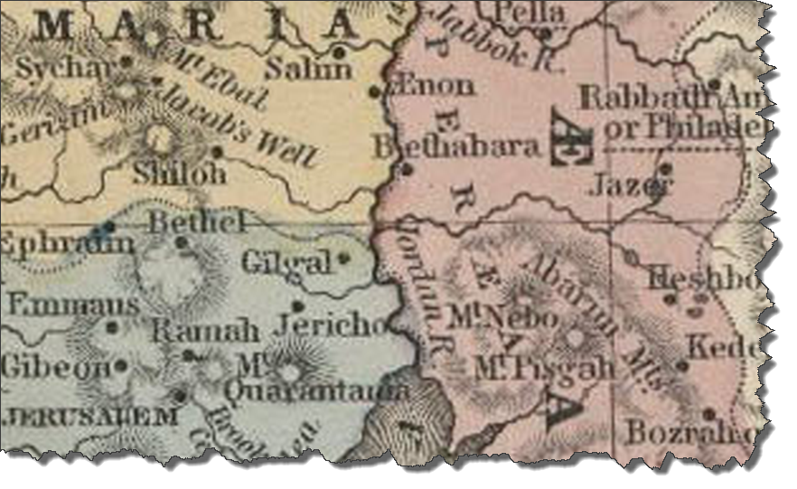
Parting of the Waters

Slide 30
Parting the Waters
1. GOD Genesis 1:6-7
2. Moses Exodus 14:21-22
3. Joshua 3:7-17 through 4:1-18
4. Elijha 2 Kings 2:7-8
5. Elisha 2 Kings 2:13-14
6. 144K – Part the Seas
7. God – Part the Heavens
Notes:
Luk_12:51 Suppose ye that I am come to give peace on earth? I tell you, Nay; but rather division See also John 7:43, John 10:19, Exo 8:23, / The seas are like people Isa 17:22

Slide 31
EGW
We all entered the cloud together, and were seven days ascending to the sea of glass, when Jesus brought the crowns, and with His own right hand placed them on our heads. He gave us harps of gold and palms of victory. Here on the sea of glass the 144,000 stood in a perfect square. Some of them had very bright crowns, others not so bright. Some crowns appeared heavy with stars, while others had but few.
Notes:
Luk_12:51 Suppose ye that I am come to give peace on earth? I tell you, Nay; but rather division See also John 7:43, John 10:19, Exo 8:23, / The seas are like people Isa 17:22

Slide 32
EGW
All were perfectly satisfied with their crowns. And they were all clothed with a glorious white mantle from their shoulders to their feet. Angels were all about us as we marched over the sea of glass to the gate of the city. Jesus raised His mighty, glorious arm, laid hold of the pearly gate, swung it back on its glittering hinges, and said to us, “You have washed your robes in My blood, stood stiffly for My truth, enter in.” We all marched in and felt that we had a perfect right in the city.—LS 66, 67.
Notes:
Luk_12:51 Suppose ye that I am come to give peace on earth? I tell you, Nay; but rather division See also John 7:43, John 10:19, Exo 8:23, / The seas are like people Isa 17:22

Slide 33
Links
www.OurLivingFoundations.com
www.pathofthejust.org
www.2520yearprophecy.com
www.theseventhunders.com
www.adventtimes.com
www.future-news.org
www.the2520.com
www.col-ministries.com
Notes:
Luk_12:51 Suppose ye that I am come to give peace on earth? I tell you, Nay; but rather division See also John 7:43, John 10:19, Exo 8:23, / The seas are like people Isa 17:22

Slide 34

Title

