Slide 1
Foundation of our Faith
Our Foundation Series

Slide 2
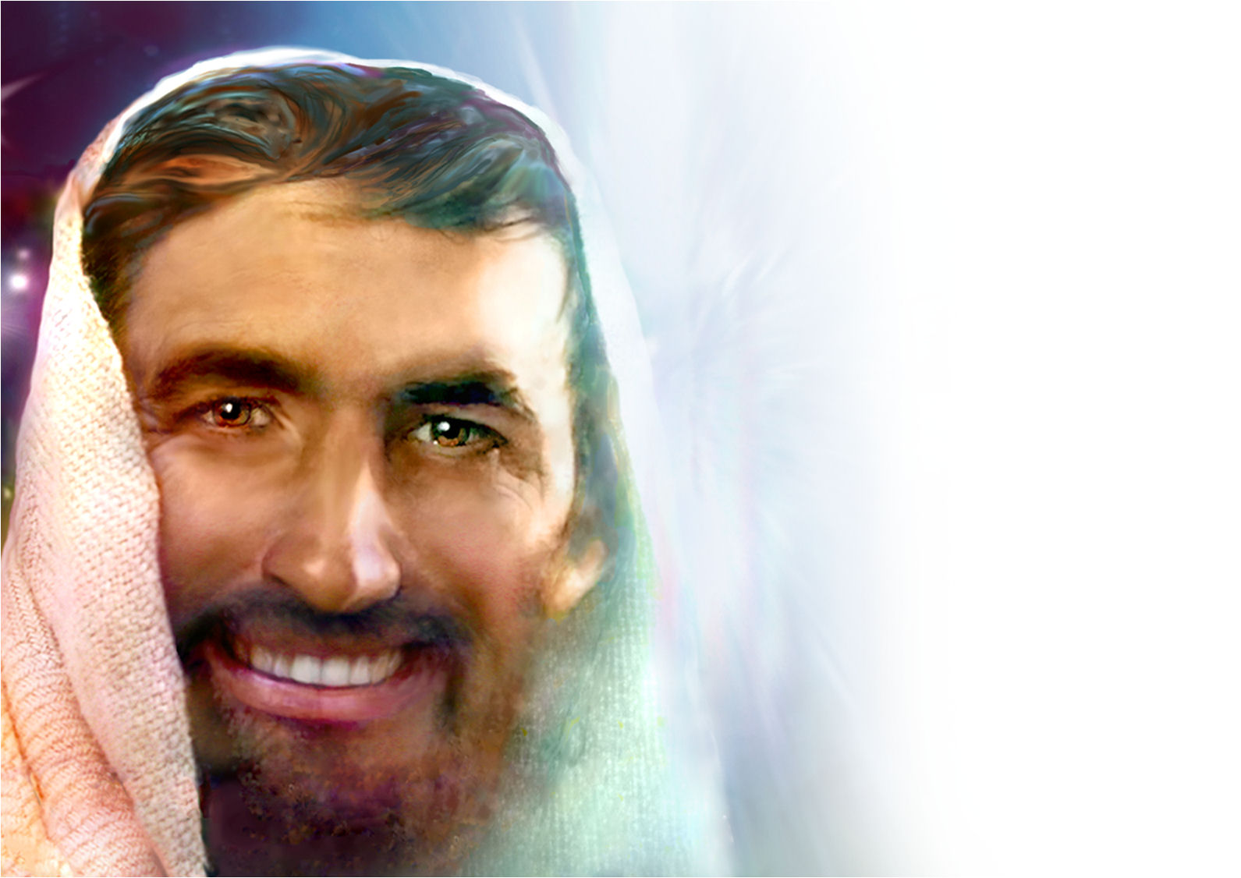
The Foundation of
Our Faith

Slide 3

Question
On the road to Emmaus, Christ
who is our Foundation established
a foundation for us through the disciples. What was it and why did He do it this way?

Slide 4
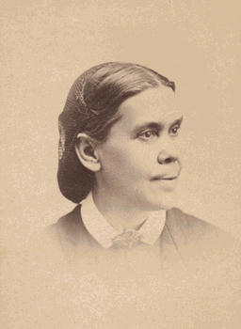
  “Beginning at Moses, the very Alpha of Bible history, Christ expounded in all the Scriptures the things concerning Himself. Had He first made Himself known to them, their hearts would have been satisfied. In the fullness of their joy they would have hungered for nothing more.

Slide 5
  But it was necessary for them to understand the witness borne to Him by the types and prophecies of the Old Testament. Upon these their faith must be established. Christ performed no miracle to convince them, but it was His first work to explain the Scriptures.

Slide 6
They had looked upon His death as the destruction of all their hopes. Now He showed from the prophets that this was the very strongest evidence for their faith.” The Desire of Ages, 796.

Slide 7
Question
What is the foundation of faith for Seventh Day Adventists?

Slide 8
  Prophecy the Foundation of Our Faith.--Ministers should present the sure word of prophecy as the foundation of the faith of Seventh-day Adventists. The prophecies of Daniel and the Revelation should be carefully studied, and in connection with them the words, "Behold the Lamb of God, which taketh away the sin of the world." {Ev 196.2}

Slide 9
Question
What is the purpose of prophecy and historical events?

Slide 10
  “Historical events, showing the direct fulfillment of prophecy, were set before the people, and prophecy was seen to be a figurative delineation of events leading down to the close of this earth’s history.” Selected Messages, book 2, 102.

Slide 11
Question
Two key words – Figurative and Delineation – what do they mean?

Slide 12
Figurative
FIG'URATIVE, a.
1. Representing something else; representing by resemblance; typical.
This they will say, was figurative, and served by God's appointment but for a time, to shadow out the true glory of a more divine sanctity.
Delineate
DELINEATE, v.t. [L.A Line.]
1. To draw the lines which exhibit the form of a thing; to mark out with lines; to make a draught; to sketch or design; as, to delineate the form of the earth, or a diagram.
Isa 28:13 Therefore shall the word of the LORD be unto them precept upon precept, precept upon precept; line upon line, line upon line; here a little, there a little; that they may go, and fall backward, and be broken, and snared, and taken.
Hab 2:2 And the LORD answered me, and said, Write the vision, and make it plain upon tables, that he may run that readeth it.
Hab 2:3 For the vision is yet for the appointed time, and it hasteth toward the end, and shall not lie: though it tarry, wait for it; because it will surely come, it will not delay.

Slide 13
Question
Did the Advent Movement bring things out line by line?

Slide 14
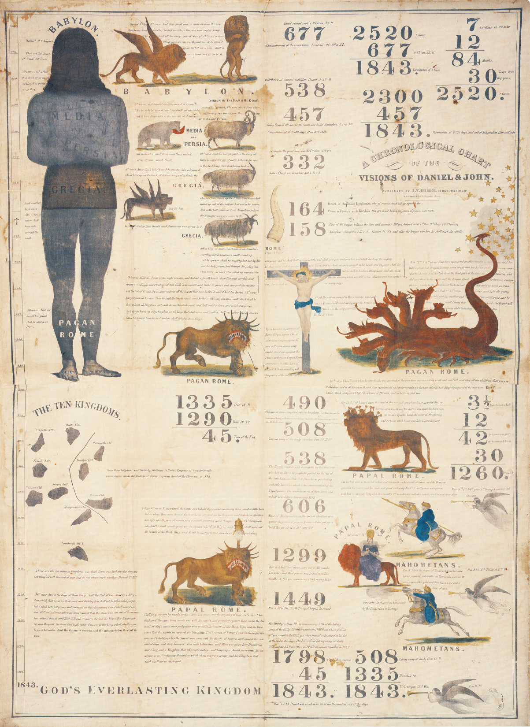
The
1843 Chart
Notes:
Note: There were 300 Preachers and there were 300 Men in Gideon’s Army.

Slide 15
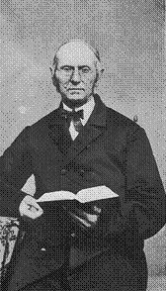
In May, 1842, a General Conference was convened in Boston, Mass. At the opening of this meeting, Brn. Charles Fitch and Apollos Hale, of Haverhill, presented the pictorial prophecies of Daniel and John, which they had painted on cloth, with the prophetic numbers, showing their fulfillment.
Notes:
Note: There were 300 Preachers and there were 300 Men in Gideon’s Army.

Slide 16
Bro. Fitch in explaining from his chart before the Conference, said, while examining these prophecies, he had thought if he could get out something of the kind as here presented it would simplify the subject and make it easier for him to present to an audience.
Notes:
Note: There were 300 Preachers and there were 300 Men in Gideon’s Army.

Slide 17
Here was more light in our pathway. These brethren had been doing what the Lord had shown Habbakuk in his vision 2468 years before, saying, "Write the vision and make it plain upon tables, that he may run that readeth it. For the vision is yet for an appointed time." Hab.ii,2.
Notes:
Note: There were 300 Preachers and there were 300 Men in Gideon’s Army.

Slide 18
After some discussion on the subject, it was voted unanimously to have three hundred similar to this one lithographed, which was soon accomplished. They were called "the '43 charts." This was a very important Conference The Autobiography of Joseph Bates 263
Notes:
Note: There were 300 Preachers and there were 300 Men in Gideon’s Army.

Slide 19
Question
Who are the prophecies for?

Slide 20
“Each of the ancient prophets spoke less for their own time than for ours, so that their prophesying is in force for us. ‘Now all these things happened unto them for ensamples: and they are written for our admonition, upon whom the ends of the world are come.’ 1 Corinthians 10:11.

Slide 21
‘Not unto themselves, but unto us they did minister the things, which are now reported unto you by them that have preached the gospel unto you with the Holy Ghost sent down from heaven; which things the angels desire to look into.’ 1 Peter 1:12. . . {3SM 338.1}

Slide 22
Question
Are the landmarks and experience of the past important to us today?
What does scripture have to say about it?

Slide 23

Thou shalt not remove thy neighbour’s landmark, which they of old time have set in thine inheritance, which thou shalt inherit in the land that the Lord thy God giveth thee to possess it. Deut. 19:14.
Cursed be he that removeth his neighbour’s landmark. And all the people shall say, Amen. Deut. 27:17.
Remove not the ancient landmark, which thy fathers have set. Prov. 22:28.

Slide 24
Question
Was the Advent (Millerite) Movement a landmark event in History?

Slide 25
Historical Fact
In 1838, based on the understanding of a day for a year principle in prophecy and applying that to Rev 9:15, Josiah Litch predicted the end of the Ottoman Empire. Ten days before the event came to pass, he published the exact date of August 11th 1840.
Notes:
It was no longer a force to be reckoned with.

Slide 26
Advent movement of 1840-44 was a glorious manifestation of the power of God; the first angel's message was carried to every missionary station in the world, and in some countries there was the greatest religious interest which has been witnessed in any land since the Reformation of the sixteenth century; but these are to be far exceeded by the mighty movement under the last warning of the third angel. {GC88 610.3}

Slide 27
Question
What is the longest time prophecy in scripture?

Slide 28

Jewish Month 30 days
Time is = year
7 Times = 7 Years
30 days x 12 months = 360 360 x 7 = 2520 years
Day for a year principle: Num 14:34 After the number of the days in which ye spied out the land, even forty days, for every day a year, shall ye bear your iniquities, even forty years, and ye shall know my alienation.
And if ye will not yet for all this hearken unto me, then I will punish you seven times more for your sins.
2520
LEV: 26:18

Slide 29
John 2:20 Then said the Jews, Forty and six years was this temple in building, and wilt thou rear it up in three days?
723 King Hoshea dies in Captivity
722 BC Israel enters into Captivity 2nd Kings 17:1-6 8,13,16-18
677 BC Judah enter into Captivity 2nd Chronicles 33:11
538 AD Fulfillment of Daniel 7:8 the Papacy takes possession of Rome.
1798 General Berthier takes the Pope prisoner to France and Rome's control of Europe is broken (politically and spiritually) Fulfillment of Daniel 12:11 - 1290 years from 508 and 1260 years from 538
2520 Year Prophecy
1260
1260
46
Israel
723
538
1798
1843/4
BC AD
Isa 7:8 For the head of Syria is Damascus, and the head of Damascus is Rezin: and within threescore and five years shall Ephraim be broken in pieces, that it be not a people:
742
2520
Isaiah 7:8
677
1843/4
Judah

Slide 30
722 BC Israel enters into Captivity 2nd Kings 17:1-6, 8,13,16-18
677 BC Judah enter into Captivity 2nd Chronicles 33:11
538 AD Fulfillment of Daniel 7:8 the Papacy takes possession of Rome
1798 General Berthier takes the Pope prisoner to France and Rome's control of Europe is broken (politically and spiritually) Fulfillment of Daniel 12:11 - 1290 years from 508 and 1260 years from 538
46 Years John 2:20 1798-1844 to build
God’s spiritual Temple - His people

Slide 31
Question
What did the Millerites teach in 1844?

Slide 32
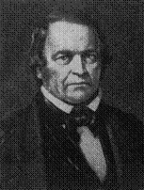
"And I will cause them to be removed into all kingdoms of the earth, because of Manasseh, the son of Hezekiah, king of Judah, for that which he did in Jerusalem," - tells us of the same thing, that Judah as well as Israel must be made captives.

Slide 33
Israel began to be carried away in the days of Hoshea, 722 B. C., and from that time to 1798 after Christ, is exactly 2520 years, or the seven prophetic years. How remarkable, that when the seven years ended, God began to deliver his church from her bondage, which for ages had been made subject to the kings of the earth.

Slide 34
In 1798 the church came out of the wilderness, and began to be delivered from her captivity. But the completion of her slavery to the kingdoms of the earth, is reserved for another period. Beginning B. C., 677 years, seven prophetic years, or 2520 common years, would end in A. D. 1843. Miller 1842

Slide 35
I have seen that the 1843 chart was directed by the hand of the Lord, and that it should not be altered; that the figures were as He wanted them; that His hand was over and hid a mistake in some of the figures, so that none could see it, until His hand was removed. {EW 74.1}

Slide 36
Question
Does this take away from the 2300 year prophecy?

Slide 37
2520 Year Prophecy
1260
1260
46
Israel
723
538
1798
1843/4
As you can see it does not affect the 2300 year prophecy. Instead it confirms it. Now we have two separate witnesses, that attest to the accuracy of the 2300 year prophecy.
BC AD
742
2520
Isaiah 7:8
677
1843/4
Judah
2300
457
1843/4
Notes:
No it does not, it sustains and confirms it!

Slide 38
Question
So what does this mean for us today? Are there any more time prophecies?

Slide 39
The First-day Adventists have set time after time, and notwithstanding the repeated failures, they have gathered courage to set new times. God has not led them in this. Many of them have denied the prophetic time and the fulfillment of prophecy, because the time passed in 1844, and did not bring the expected event. They rejected the true prophetic time, and the enemy has brought strong delusions upon them that they should believe a lie…
I have borne the testimony since the passing of the time in 1844, that there should be no definite time set by which to test God's people. The great test on time was in 1843 and 1844; and all who have set time since this great period marked in prophecy, were deceiving and being deceived. {LS88 221.1

Slide 40
2520 Year Prophecy
1260
1260
46
Israel
723
538
1798
1843/4
BC AD
742
2520
Isaiah 7:8
677
1843/4
Judah
2300
457
1843/4

Slide 41
Question
Do we have a new message?

Slide 42
Those who stand as teachers and leaders in our institutions are to be sound in the faith and in the principles of the third angel's message. God wants His people to know that we have the message as He gave it to us in 1843 and 1844. We knew then what the message meant, and we call upon our people today to obey the word, "Bind up the law among My disciples.”

Slide 43
In this world there are but two classes,--the obedient and the disobedient. To which class do we belong? God wants to make us a peculiar people, a holy nation. He has separated us from the world, and He calls upon us to stand on vantage ground, where He can bestow on us His Holy Spirit. {GCB, April 1, 1903 par. 42}

Slide 44
God is not giving us a new message. We are to proclaim the message that in 1843 and 1844 brought us out of the other churches. R&H 19th January 1905
God bids us give our time and strength to the work of preaching to the people the messages the stirred men and women in 1843 and 1844. MR #760

Slide 45
Question
What are we to do and what is the loud cry message?

Slide 46
“All the messages given from 1840-1844 are to be made forcible now, for there are many people who have lost their bearings. The messages are to go to all the churches. Christ said, Blessed are your eyes, for they see; and your ears, for they hear.

Slide 47
For verily I say unto you, That many prophets and righteous men have desired to see those things which ye see, and have not seen them; and to hear those things which you hear, and have not heard them. (Matt 13:16,17)

Slide 48
Blessed are the eyes which saw the things that were seen in 1843 and 1844. “The message was given. And there should be no Delay in repeating the message, for the signs of the times are fulfilling; the closing work must be done. A great work will be done in a short time. A message will soon be given by God’s appointment that will swell into a lound cry. Then Daniel will stand in his lot, to give his testimony. MR Vol 21, 437

Slide 49
Question
What message will be preached in the last days?

Slide 50
The Lord has shown me that the message of the third angel must go, and be proclaimed to the scattered children of the Lord, but it must not be hung on time. I saw that some were getting a false excitement, arising from preaching time;

Slide 51
but the third angels message is stronger than time can be. I saw that this message can stand on its own foundation and needs not time to strengthen it; and that it will go in mighty power, and do its work, and will be cut short in righteousness. {EW 75.1}

Slide 52
Question
Therefore what are we called to be?

Slide 53
As a people, we are called individually to be students of prophecy. We must watch with earnestness that we may discern any ray of light which God shall present to us. We are to catch the first gleamings of truth; and through prayerful study, clearer light may be obtained, which can be brought before others. {CW 41.1}
The time is now !

Slide 54
Conclusion
We are to study and teach the three Angels message as it was understood from 1843-44. When we do this, new light will come. As we do this He will come whether we are ready for Him or not ….

Slide 55
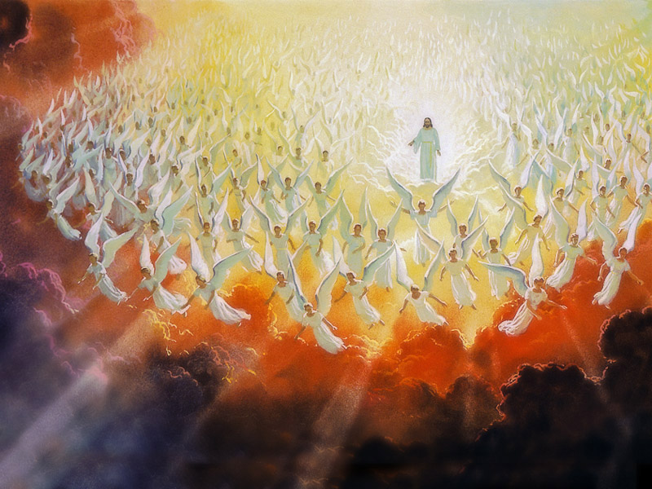

Slide 56
It will happen !
The question now is, are you ready for what is to come?

Slide 57
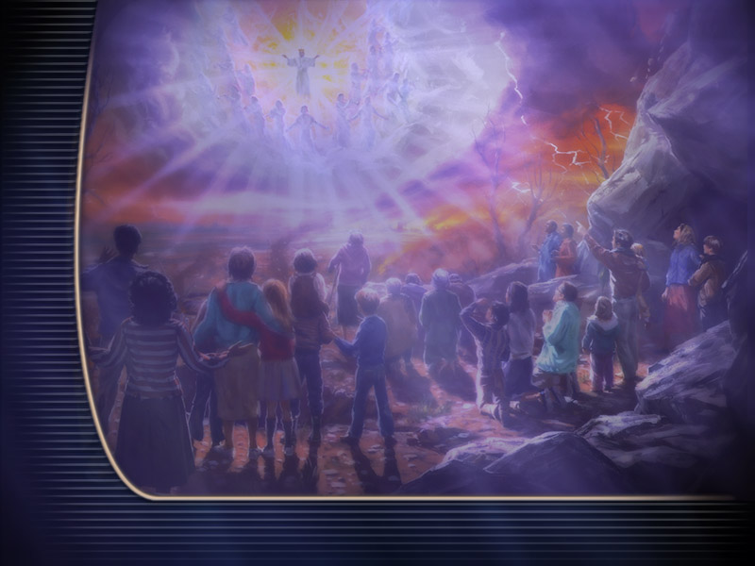

Slide 58
The Invitation
The choice is yours. He wants you to come; do you really want to go?

Slide 59
