Slide 1
2520 Year Prophecy
2008 Prophecy School

Slide 2
Question
What is the foundation of faith for Seventh Day Adventists?

Slide 3
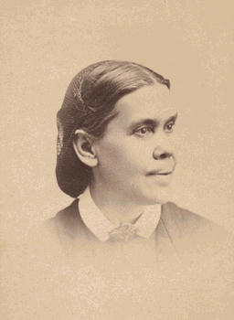
EGW
  Prophecy the Foundation of Our Faith.--Ministers should present the sure word of prophecy as the foundation of the faith of Seventh-day Adventists. The prophecies of Daniel and the Revelation should be carefully studied, and in connection with them the words, "Behold the Lamb of God, which taketh away the sin of the world." {Ev 196.2}

Slide 4
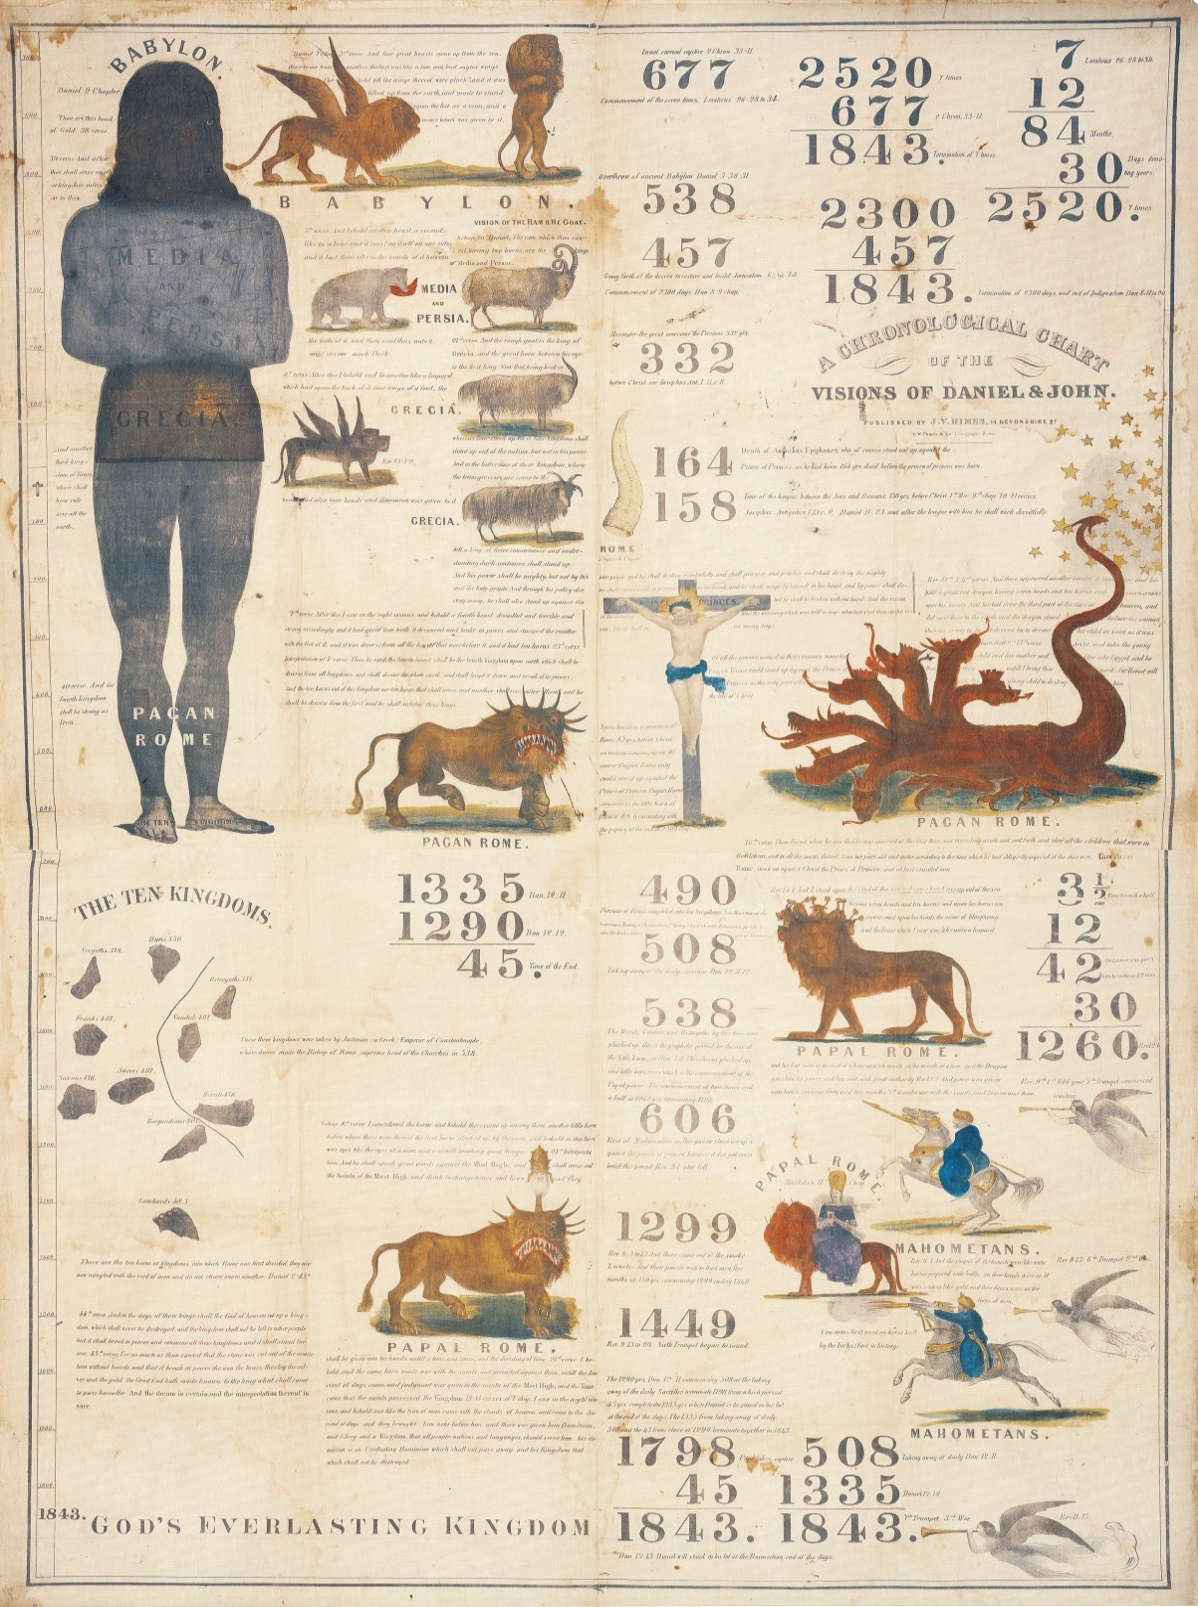
1843 Chart

Slide 5

Conclusion
2520
1260
1260
46
Israel
723
538
1798
1843/4
BC
AD
742
2520
Isaiah 7:8
677
1843/4
Judah
2300
508
457
1843/4

Slide 6
Content 2520 Year Prophecy
Pioneer (Historical) Understanding
  Reckoning of Years / Calendars
  Understanding Time
Scattering & Gathering
Seven Times
Purpose of Prophecy
2520 Year Prophecy
Repeat & Enlarge (Ezekiel 37)
1st Kings 17
Daniel
Conclusion

Slide 7
Historical Understanding 2520
2008 Prophecy School

Slide 8
Question
How did Miller discover the 2520 & 2300 Year prophecies?

Slide 9
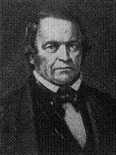
Miller
I began at Genesis and read on slowly; and when I came to a text that I could not understand, I searched through the Bible to find out what it meant. After I had gone through the Bible in this way, O, how bright and glorious the truth appeared. I found what I have been preaching to you. I was satisfied that the seven times terminated in 1843.

Slide 10
Miller
Then I came to the 2300 days; they brought me to the same conclusion; but I had no thought of finding out when the Saviour was coming, and I could not believe it; but the light struck me so forcibly I did not know what to do.

Slide 11
Miller
Now, I thought, I must put on spurs and breeching; I will not go faster than the Bible, and I will not fall behind it. Whatever the Bible teaches I will hold on to it.“ US 8R&H2 page 0009 paragraph 18 1856 Vol VIII

Slide 12
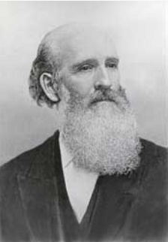
James White
"Our minds were directed to that point of time, [1843,] from the fact that dating the several prophetic periods from those years in which the best chronologers assign the fulfillment of those events which were to mark their commencement, they all seemed to terminate that year.

Slide 13
James White
This was, however, only apparent. We date the `seven times,' or 2520 years, from the captivity of Manasseh, which is, with great unanimity, placed by chronologers B. C. 677.

Slide 14
James White
This date is the only one we have ever reckoned from, for the commencement of this period; and subtracting B. C. 677 from 2520 years, there remained but A. D. 1843.

Slide 15
James White
We, however, did not observe that as it would require 677 full years B. C. and 1843 full years A. D. to complete 2520 years, that it would also oblige us to extend this period as far into A. D. 1844 as it might have commenced after the beginning of B. C. 677.

Slide 16
Calendars & Dating
2008 Prophecy School

Slide 17
Calendars & Dating
First 2520 is a full number.
Second when moving between BC & AD adding a the year zero separates time and dates.

Slide 18
Calendars & Dating
Third there is no year zero in the widely used Gregorian Calendar, nor in its predecessor, the Julian Calendar. However, there is a year zero in astronomical year numbering (where it coincides with the Julian year 1 BC) and in the calendar ISO 8601.2004 (where it coincides with the Gregorian year 1 BC) as well as in all Buddhist and Hindu Lunar Calendars.

Slide 19
Understanding Time
1
0
1
1
BC
AD
1
1
0
1
1
BC
BC
AD
AD
2520 – 722 = 1798
/ 7
/9
2300 – 457 = 1843
/ 2
/4
2520 – 677 = 1843
/ 2
/4

Slide 20
James White
The same was also true of the other periods. The great jubilee of 2450 years, commencing with the captivity of Jehoiakim B. C. 607; and the 2300 days, commencing with the 70 weeks B. C.

Slide 21
James White
457, would respectively require 1843 full years after Christ added to as many full years before Christ, as the years in which we have always respectively commenced each period, to complete the number of years in each; and as subtracting from

Slide 22
James White
each period the date B. C. of its commencement, there would remain A. D. 1843, no reference whatever was made to the fraction of the year, which, in each case, had transpired from its commencement,

Slide 23
James White
and which would require that each period should extend as much beyond the expiration of A. D. 1843, as they respectively began after the commencement of the year B. C. from which they are dated

Slide 24
James White
While this discrepancy was not particularly noticed by us, it was also not noticed by any of our learned opponents. Amid all the arguments which were brought to bear against our position,

Slide 25
James White
no allusion was made to that point; and time alone accomplished what our opponents had been unable to do, in showing our mistake in the definite year. [The Advent Review Vol. I.] - Auburn, (N. Y.) August, 1850 - [NO. 1.]

Slide 26
EGW
I have seen that the 1843 chart was directed by the hand of the Lord, and that it should not be altered; that the figures were as He wanted them; that His hand was over and hid a mistake in some of the figures, so that none could see it, un til His hand was removed. {EW 74.1}

Slide 27
2520 Scattering & Gathering
Prophecy School 2008

Slide 28
Daniel 12:6 Question
And one said to the man clothed in linen, which was upon the waters of the river, How long shall it be to the end of these wonders? (Dan 12:6)

Slide 29
Daniel 12:7 Answer
And I heard the man clothed in linen, which was upon the waters of the river, when he held up his right hand and his left hand unto heaven, and sware by him that liveth for ever that it shall be for a time, times, and an half; and when he shall have accomplished to scatter the power of the holy people, all these things shall be finished.(Dan 12:7)

Slide 30
Daniel 9:11
Yea, all Israel have transgressed thy law, even by departing, that they might not obey thy voice; therefore the curse is poured upon us, and the oath that is written in the law of Moses the servant of God, because we have sinned against him.(Dan 9:11)

Slide 31
Daniel 9:13
As it is written in the law of Moses, all this evil is come upon us: yet made we not our prayer before the LORD our God, that we might turn from our iniquities, and understand thy truth.(Dan 9:13)

Slide 32
Leviticus 26
And if ye will not yet for all this hearken unto me, then I will punish you seven times more for your sins. (Lev 26:18)
And if ye walk contrary unto me, and will not hearken unto me; I will bring seven times more plagues upon you according to your sins. (Lev 26:21)

Slide 33
Leviticus
Then will I also walk contrary unto you, and will punish you yet seven times for your sins. (Lev 26:24)
Then I will walk contrary unto you also in fury; and I, even I, will chastise you seven times for your sins. (Lev 26:28)

Slide 34
Leviticus
And I will scatter you among the heathen, and will draw out a sword after you: and your land shall be desolate, and your cities waste. (Lev 26:33)

Slide 35

Miller
Moses' prophecy of the scattering of the people of God among all nations "seven times;" see Lev.xxvi.14-46. It is evident that these "seven times" were a succession of years, for their land was to lie desolate as long as they were in their enemies' land.

Slide 36
Miller
And the people of God have been scattered, and are now a scattered and a peeled people. These "seven times" are not yet accomplished, for Daniel says, "When he shall have accomplished to scatter the power of the holy people all these things shall be finished.”

Slide 37
Miller
The resurrection and judgment will take place. Dan.xii.6,7: "And one said to the man clothed in linen, which was upon the waters of the river, How long shall it be to the end of these wonders? And I heard the man clothed in linen, which was upon the waters of the river,

Slide 38
Miller
when he held up his right hand and his left hand unto heaven, and sware by him that liveth forever, that it shall be for a time, times, and a half: and when he shall have accomplished to scatter the power of the holy people, all these things shall be finished.”

Slide 39
Miller
What did the angel mean by time, times, and a half? I answer, he meant three years and a half prophetic, or forty-two months, as in Rev.xi.2, and xiii.5; or 1260 prophetic days, as in Rev.xi.3, and xii.6 and 14. He meant the one half of "seven times.”

Slide 40
Miller
Daniel saw the same thing as Moses, only to Daniel the time was divided. He was informed that the little horn would "speak great words against the Most High, and shall wear out the saints of the Most High, and think to change times and laws;

Slide 41
Miller
and they shall be given into his hand until a time, times, and the dividing of time." This makes Moses' seven times, for twice three and a half are seven, and twice 1260 are 2520 common years. But you may inquire, are not these two things the same in Daniel?

Slide 42
Miller
I answer, no. For their work is different, and their time of existence is at different periods. The one scatters the holy people; the other wears out the saints. The one means the kingdoms which Daniel and John saw; the other means Papacy,

Slide 43
Miller
which is called the little horn, which had not come up when the people of God were scattered by Babylon and the Romans. The first means literal Babylon or the kings of the earth, the other means mystical Babylon or Papacy. And both together would scatter the holy people and wear out the saints "seven times," or 2520 years.{Millers Works Vol #1 pg 44-45}

Slide 44
Seven Times
2008 Prophecy School

Slide 45
Seven Times
A LECTURE ON THE TYPICAL SABBATHS AND GREAT JUBILEE. BY WILLIAM MILLER, OF LOW HAMPTON, NEW YORK. PUBLISHED BY JOSHUA V. HIMES, 1842.

Slide 46
Miller
When, then, may we not ask, did the bondage of the children of God begin? I answer, when literal Babylon began to exercise authority over them. In the twenty-second year of Manasseh's reign, in the year before Christ 677, the last of the ten tribes were carried away,

Slide 47
Miller
and Israel ceased to be a nation, according to the prophecy of Isaiah, vii.8: "For the head of Syria is Damascus, and the head of Damascus is Rezin: and within three-score and five years shall Ephraim be broken, that it be not a people."

Slide 48
Miller
Isaiah prophesied this in the year 742 before Christ, which prophecy was literally fulfilled in sixty-five years afterwards, in the year B. C. 677. Then, too, Manasseh king of Judah was carried a captive into Babylon, and the threatenings of God began upon his people.

Slide 49
Miller
2Kings xxi.10-14: "And the Lord spake by his servants the prophets, saying, because Manasseh, king of Judah, hath done these abominations, and hath done wickedly above all that the Amorites did,

Slide 50
Miller
which were before him, and hath made Judah also to sin with his idols: therefore, thus saith the Lord God of Israel, Behold, I am bringing such evil upon Jerusalem and Judah, that whosoever heareth of it, both his ears shall tingle.

Slide 51
Miller
And I will stretch over Jerusalem the line of Samaria, and the plummet of the house of Ahab: and I will wipe Jerusalem as a man wipeth a dish, wiping it, and turning it upside down. And I will forsake the remnant of mine inheritance, and deliver them into the hand of

Slide 52
Miller
their enemies; and they shall become a prey and a spoil to all their enemies." Also, xxiv.3,4: "Surely at the commandment of the Lord came this upon Judah, to remove them out of his sight, for the sins of Manasseh, according to all that he did;
Notes:
2kings 21:14

Slide 53
Miller
acts, yet the Lord turned not from the fierceness of his wrath against Judah. 2Kings xxiii.26,27: "Notwithstanding, the Lord turned not from the fierceness of his great wrath, wherewith his anger was kindled against Judah, because of all the provocations that Manasseh had provoked him withal.

Slide 54
Miller
And the Lord said, I will remove Judah also out of my sight, as I have removed Israel, and will cast off this city Jerusalem which I have chosen, and the house of which I said, My name shall be there."

Slide 55
Miller
The decree against Judah, was the same as against Israel. They must be scattered among all nations. It could not be revoked, notwithstanding their repentance and partial reformation.

Slide 56
Miller
Jeremiah xv.4, - "And I will cause them to be removed into all kingdoms of the earth, because of Manasseh, the son of Hezekiah, king of Judah, for that which he did in Jerusalem," - tells us of the same thing, that Judah as well as Israel must be made captives.

Slide 57
Miller
Israel began to be carried away in the days of Hoshea, 722 B. C., and from that time to 1798 after Christ, is exactly 2520 years, or the seven prophetic years.

Slide 58
Miller
How remarkable, that when the seven years ended, God began to deliver his church from her bondage, which for ages had been made subject to the kings of the earth. In 1798 the church came out of the wilderness, and began to be delivered from her captivity.

Slide 59
Miller
But the completion of her slavery to the kingdoms of the earth, is reserved for another period. Beginning B. C., 677 years, seven prophetic years, or 2520 common years, would end in A. D. 1843.

Slide 60
Miller
Therefore, beginning at the captivity of Manasseh and the final dispersion of the ten tribes of Israel, where God has fixed the time for the dispersion of the people of God and the scattering of the holy people, until the year 1843, will be the end of the seven years, when the acceptable year of the LORD will commence

Slide 61
Miller
and, in my humble opinion, the children of God will be delivered from all the evils enumerated by Moses in Leviticus xxvi., and Jeremiah xv.; from war or the sword, from pestilence and famine, from captivity and spoil, from death and corruption;

Slide 62
Miller
and all will be comforted, and all tears be wiped from off all faces; sighs and sorrows shall cease forever, and there shall be no more curse, for the throne of the Lamb shall be there, and he shall dwell with them, and be their God, and they shall be his people.

Slide 63
begin to
This will take place in the acceptable year of the Lord, the antitypical year of release.
2520
46
Israel
723
538
1798
1843/4
BC
AD
742
2520
Isaiah 7:8
Judah
677
1843/4

Slide 64
EGW “Gathering Time”
September 23, the Lord showed me that He had stretched out His hand the second time to recover the remnant of His people, and that efforts must be redoubled in this gathering time. In the scattering, Israel was smitten and torn, but now in the gathering time God will heal and bind up His people.

Slide 65
“Gathering Time”
In the scattering, efforts made to spread the truth had but little effect, accomplished but little or nothing; but in the gathering, when God has set His hand to gather His people, efforts to spread the truth will have their designed effect.

Slide 66
“Gathering Time”
All should be united and zealous in the work. I saw that it was wrong for any to refer to the scattering for examples to govern us now in the gathering;

Slide 67
“Gathering Time”
for if God should do no more for us now than He did then, Israel would never be gathered. I have seen that the 1843 chart was directed by the hand of the Lord, and that it should not be altered;

Slide 68
“Gathering Time”
that the figures were as He wanted them; that His hand was over and hid a mistake in some of the figures, so that none could see it, until His hand was removed.

Slide 69
1843 Chart

Slide 70
Purpose of Prophecy
2008 Prophecy School

Slide 71

Question
What is the purpose of prophecy and historical events?

Slide 72
EGW
  “Historical events, showing the direct fulfillment of prophecy, were set before the people, and prophecy was seen to be a figurative delineation of events leading down to the close of this earth’s history.” Selected Messages, book 2, 102.

Slide 73
Question
Two key words – Figurative and Delineation – what do they mean?

Slide 74
Definition
Figurative FIG'URATIVE, a.
1. Representing something else; representing by resemblance; typical.

Slide 75
Definition
Delineate
DELINEATE, v.t. [L.A Line.]
1. To draw the lines which exhibit the form of a thing; to mark out with lines; to make a draught; to sketch or design; as, to delineate the form of the earth, or a diagram.

Slide 76
Scripture Text
Isa 28:13 Therefore shall the word of the LORD be unto them precept upon precept, precept upon precept; line upon line, line upon line; here a little, there a little; that they may go, and fall backward, and be broken, and snared, and taken.

Slide 77
Scripture Text
Hab 2:2 And the LORD answered me, and said, Write the vision, and make it plain upon tables, that he may run that readeth it.
Hab 2:3 For the vision is yet for the appointed time, and it hasteth toward the end, and shall not lie: though it tarry, wait for it; because it will surely come, it will not delay.

Slide 78
Question
Did the Advent Movement bring things out line by line?

Slide 79

1843 Chart

Slide 80
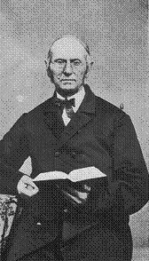
Captain Bates
In May, 1842, a General Conference was convened in Boston, Mass. At the opening of this meeting, Brn. Charles Fitch and Apollos Hale, of Haverhill, presented the pictorial prophecies of Daniel and John, which they had painted on cloth, with the prophetic numbers, showing their fulfillment.

Slide 81
Captain Bates
Bro. Fitch in explaining from his chart before the Conference, said, while examining these prophecies, he had thought if he could get out something of the kind as here presented it would simplify the subject and make it easier for him to present to an audience.

Slide 82
Captain Bates
Here was more light in our pathway. These brethren had been doing what the Lord had shown Habbakuk in his vision 2468 years before, saying, "Write the vision and make it plain upon tables, that he may run that readeth it. For the vision is yet for an appointed time." Hab.ii,2.

Slide 83
Question
Who are the prophecies for?

Slide 84
EGW
“Each of the ancient prophets spoke less for their own time than for ours, so that their prophesying is in force for us. ‘Now all these things happened unto them for ensamples: and they are written for our admonition, upon whom the ends of the world are come.’ 1 Corinthians 10:11.

Slide 85
EGW
‘Not unto themselves, but unto us they did minister the things, which are now reported unto you by them that have preached the gospel unto you with the Holy Ghost sent down from heaven; which things the angels desire to look into.’ 1 Peter 1:12. . . {3SM 338.1}

Slide 86
Question
Are the landmarks and experience of the past important to us today?
What does scripture tell us?

Slide 87
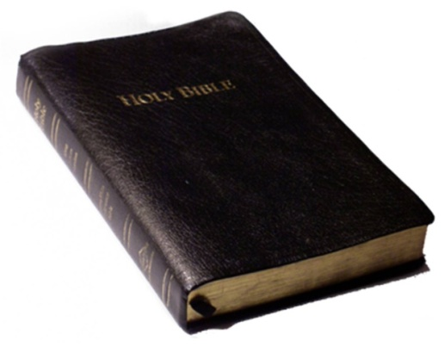
Scripture
Thou shalt not remove thy neighbour’s landmark, which they of old time have set in thine inheritance, which thou shalt inherit in the land that the Lord thy God giveth thee to possess it. Deut. 19:14.

Slide 88
Scripture
Cursed be he that removeth his neighbour’s landmark. And all the people shall say, Amen. Deut. 27:17.
Remove not the ancient landmark, which thy fathers have set. Prov. 22:28.

Slide 89
Question
Was the Advent (Millerite) Movement a landmark event in History?

Slide 90
Historical Fact
In 1838, based on the understanding of a day for a year principle in prophecy and applying that to Rev 9:15, Josiah Litch predicted the end of the Ottoman Empire. Ten days before the event came to pass, he published the exact date of August 11th 1840. 391 years and 15 days exactly!!

Slide 91
EGW
Advent movement of 1840-44 was a glorious manifestation of the power of God; the first angel's message was carried to every missionary station in the world, and in some countries there was the greatest religious interest which has been

Slide 92
EGW
in any land since the Reformation of the sixteenth century; but these are to be far exceeded by the mighty movement under the last warning of the third angel. {GC88 610.3}

Slide 93
THE 2520 Year Prophecy
2008 Prophecy School Ozark

Slide 94
Question
What is the longest time prophecy in scripture?

Slide 95

Day for a year principle: Num 14:34 After the number of the days in which ye spied out the land, even forty days, for every day a year, shall ye bear your iniquities, even forty years, and ye shall know my alienation.
Jewish Month 30 days
Time is = year
7 Times = 7 Years
30 days x 12 months = 360 360 x 7 = 2520 years
And if ye will not yet for all this hearken unto me, then I will punish you seven times more for your sins.
2520
LEV: 26:18

Slide 96
John 2:20 Then said the Jews, Forty and six years was this temple in building, and wilt thou rear it up in three days?
723 BC King Hoshea dies in Captivity
722 BC Israel enters into Captivity 2nd Kings 17:1-6 8,13,16-18
677 BC Judah enter into Captivity 2nd Chronicles 33:11
538 AD Fulfillment of Daniel 7:8 the Papacy takes possession of Rome.
1798 General Berthier takes the Pope prisoner to France and Rome's control of Europe is broken (politically and spiritually) Fulfillment of Daniel 12:11 - 1290 years from 508 and 1260 years from 538
2520 Year Prophecy
10
1260
1260
46
Israel
723
538
1798
1843/4
Isa 7:8 For the head of Syria is Damascus, and the head of Damascus is Rezin: and within threescore and five years shall Ephraim be broken in pieces, that it be not a people:
BC AD
742
2520
Isaiah 7:8
677
1843/4
Judah
2

Slide 97
723 BC King Hoshea dies in Captivity
722 BC Israel enters into Captivity 2nd Kings 17:1-6, 8,13,16-18
677 BC Judah enter into Captivity 2nd Chronicles 33:11
538 AD Fulfillment of Daniel 7:8 the Papacy takes possession of Rome

Slide 98
1798 General Berthier takes the Pope prisoner to France and Rome's control of Europe is broken (politically and spiritually) Fulfillment of Daniel 12:11 - 1290 years from 508 and 1260 years from 538
46 Years John 2:20 1798-1844 to build
God’s spiritual Temple - His people

Slide 99
EGW
I have seen that the 1843 chart was directed by the hand of the Lord, and that it should not be altered; that the figures were as He wanted them; that His hand was over and hid a mistake in some of the figures, so that none could see it, until His hand was removed. {EW 74.1}

Slide 100
Question
Does this take away from the 2300 year prophecy?

Slide 101
Chart
2520 Year Prophecy
1260
1260
46
As you can see it does not affect the 2300 year prophecy. Instead it confirms it. Now we have two separate witnesses, that attest to the accuracy of the 2300 year prophecy.
Israel
723
538
1798
1843/4
BC AD
742
2520
Isaiah 7:8
677
1843/4
Judah
2300
457
1843/4
Notes:
No it does not, it sustains and confirms it!

Slide 102
Question
So what does this mean for us today?
Are there any more time prophecies?

Slide 103
EGW
The First-day Adventists have set time after time, and notwithstanding the repeated failures, they have gathered courage to set new times. God has not led them in this. Many of them have denied the prophetic time and the fulfillment of prophecy, because the time passed in 1844, and did not bring the expected event.

Slide 104
EGW
They rejected the true prophetic time, and the enemy has brought strong delusions upon them that they should believe a lie … {1T pg}73

Slide 105
2520 Year Prophecy
1260
1260
46
Israel
723
538
1798
1843/4
BC AD
742
2520
Isaiah 7:8
677
1843/4
Judah
2300
457
1843/4

Slide 106
2520 Ezekiel 37
2008 Prophecy School

Slide 107
EGW “Dry Bones”
I lay down my pen and lift up my soul in prayer, that the Lord would breathe upon His backslidden people, who are as dry bones, that they may live. The end is near, stealing upon us so stealthily, so imperceptibly, so noiselessly, like the muffled tread of the thief in the night, to surprise the sleepers off guard and unready.

Slide 108
EGW “Dry Bones”
May the Lord grant to bring His Holy Spirit upon hearts that are now at ease, that they may no longer sleep as do others, but watch and be sober.--General Conference Bulletin, 1893, pp. 132, 133. {ChS 41.2}

Slide 109
EGW “Dry Bones”
When the converting power of God comes upon the people they will become workers.--This class is well represented by the valley of dry bones Ezekiel saw in vision. Those who have had committed to them the treasures of truth, and yet who are dead in trespasses and sin, need to be created anew in Christ Jesus.

Slide 110
EGW “Dry Bones”
There is so little real vitality in the church at the present time, that it takes constant labor to give men the appearance of life to the professed people of God. When the converting power of God comes upon the people, it will be made manifest by activity. They will become workers, and will esteem the reproach of Christ greater riches than the treasures of the world.--RH Jan. 17, 1893. {PaM 154.2}

Slide 111
Scripture – Ezekiel 37:1-28
Eze 37:1-14 The hand of the LORD was upon me, and carried me out in the spirit of the LORD, and set me down in the midst of the valley which was full of bones, (2) And caused me to pass by them round about: and, behold, there were very many in the open valley; and, lo, they were very dry. (3) And he said unto me, Son of man, can these bones live? And I answered, O Lord GOD, thou knowest.

Slide 112
Scripture – Ezekiel 37:1-28
(4) Again he said unto me, Prophesy upon these bones, and say unto them, O ye dry bones, hear the word of the LORD. (5) Thus saith the Lord GOD unto these bones; Behold, I will cause breath to enter into you, and ye shall live: (6) And I will lay sinews upon you, and will bring up flesh upon you, and cover you with skin, and put breath in you, and ye shall live; and ye shall know that I am the LORD.

Slide 113
Scripture – Ezekiel 37:1-28
(7) So I prophesied as I was commanded: and as I prophesied, there was a noise, and behold a shaking, and the bones came together, bone to his bone. (8) And when I beheld, lo, the sinews and the flesh came up upon them, and the skin covered them above: but there was no breath in them. (9) Then said he unto me, Prophesy unto the wind, prophesy, son of man, and say to the wind, Thus saith the Lord GOD;

Slide 114
Scripture – Ezekiel 37:1-28
Come from the four winds, O breath, and breathe upon these slain, that they may live. (10) So I prophesied as he commanded me, and the breath came into them, and they lived, and stood up upon their feet, an exceeding great army. (11) Then he said unto me, Son of man, these bones are the whole house of Israel: behold, they say, Our bones are dried, and our hope is lost: we are cut off for our parts.

Slide 115
Scripture – Ezekiel 37:1-28
(12) Therefore prophesy and say unto them, Thus saith the Lord GOD; Behold, O my people, I will open your graves, and cause you to come up out of your graves, and bring you into the land of Israel. (13) And ye shall know that I am the LORD, when I have opened your graves, O my people, and brought you up out of your graves,

Slide 116
Scripture – Ezekiel 37:1-28
(14) And shall put my spirit in you, and ye shall live, and I shall place you in your own land: then shall ye know that I the LORD have spoken it, and performed it, saith the LORD.

Slide 117
Scripture Comparison
Then said he unto me, Prophesy unto the wind, prophesy, son of man, and say to the wind, Thus saith the Lord GOD; Come from the four winds, O breath, and breathe upon these slain, that they may live. (Eze 37:9)
And the earth was without form, and void; and darkness was upon the face of the deep. And the Spirit of God moved upon the face of the waters. (Gen 1:2)

Slide 118
Scripture Comparison
And the LORD God formed man of the dust of the ground, and breathed into his nostrils the breath of life; and man became a living soul. (Gen 2:7)

Slide 119
Summary
“Prophesy” mentioned “seven times”
Our Lord tells Ezekiel to Prophecy but he does not. Hence the command is for those who understand in the last days what their duty is now and that is to prophecy so that life will come back into the “dry bones”.
This is confirmed by the understanding of Ezekiel 37:9 / Genesis 1:2 / 2:7.

Slide 120
2520 Repeat & Enlarge
2008 Prophecy School

Slide 121
GOD’S CURSE (OF MOSES) LEV 26:14, 18-24 CURSED 7 TIMES, TIMES 12 (MONTHS) TIMES 30 DAYS =2520
2520
1798 – GENERAL BERTIER TAKES POPE PRISONER (DEADLY WOUND) DANIEL 12:11
20 YEARS FROM CURSE
ISRAEL (NORTHERN KINGDOM) ENTERS CAPTIVITY 722 BC
II KINGS 17:1-6,8,13,16-18
1260
1260
46
John 2:20 – 46 YEARS TO REBUILD SPIRITUAL TEMPLE
ISRAEL
723 BC
538
1798
1844
538 AD - PAPACY TAKES POSSESSION OF ROME DANIEL 7:8
AUG 11,1840 OTTOMAN EMPIRE ENDS 391 YRS, 15 DAYS REV 9:15
1290 YEARS – DAN 12:11
508
1335 YEARS – DAN 12:12
65 YEARS FROM PREDICITION - ISAIAH 7:8
JUDAH (EPHRAIM-SOUTHERN KINGDOM) ENTERS CAPTIVITY
II CHRONICLES 33:11
BC AD
2520
2300
JUDAH
677 BC
457 BC
1844
330
395
428
451
476
538
1299
1449
1840
1842
321 AD
1844
321 ……SUNDAY LAW (CONSTANTINE) 330 …… CAPITAL MOVED FROM ROME TO CONSTANTINOPLE 395 …… ALERIC ARRIVES 1ST TRUMPET 428 .….. GENSERIC 2ND TRUMPET 451 …… ATILLA THE HUN ATTACKS ROME 3RD TRUMPET 476 .….. ODOACER BROUGHT FINAL DEMISE TO WESTERN ROME 4TH TRUMPET 538 …… PAPACY BEGAN TO RULE THE WORLD (1ST WOE) 1299 ….. OTTOMAN EMPIRE BEGINS (TURKISH ISLAM) 1449 ….. FIRST WOE CONCLUDES (CONSTANTINE ASKS PERMISSION TO ASCEND THRONE) 2nd WOE BEGINS 1840 ….. OTTOMAN EMPIRE ENDS AUGUST 11TH 1840 1842 ….. PROTESTANT CHURCHES CLOSE DOORS TO 2520 MESSAGE Chart by Stan Wolcott

Slide 122
Scripture Text
And the LORD answered me, and said, Write the vision, and make it plain upon tables, that he may run that readeth it. For the vision is yet for an appointed time, but at the end it shall speak, and not lie: though it tarry, wait for it; because it will surely come, it will not tarry.(Hab 2:2-3)

Slide 123
EGW
The waiting ones rejoiced that He who knows the end from the beginning had looked down through the ages, and, foreseeing their disappointment, had given them words of courage and hope. Had it not been for such portions of Scripture, showing that they were in the right path, their faith would have failed in that trying hour. {SR 367.1}

Slide 124
Ezekiel 37:15-23
15 The word of the LORD came again unto me, saying, (16) Moreover, thou son of man, take thee one stick, and write upon it, For Judah, and for the children of Israel his companions: then take another stick, and write upon it, For Joseph, the stick of Ephraim, and for all the house of Israel his companions: (17) And join them one to another into one stick; and they shall become one in thine hand.

Slide 125
Ezekiel 37:15-23
(18) And when the children of thy people shall speak unto thee, saying, Wilt thou not shew us what thou meanest by these? (19) Say unto them, Thus saith the Lord GOD; Behold, I will take the stick of Joseph, which is in the hand of Ephraim, and the tribes of Israel his fellows, and will put them with him, even with the stick of Judah, and make them one stick, and they shall be one in mine hand.

Slide 126
2520 Year Prophecy
1260
1260
46
Israel
723
538
1798
1843/4
BC AD
742
2520
Isaiah 7:8
677
1843/4
Judah

Slide 127
Ezekiel 37:15-23
(20) And the sticks whereon thou writest shall be in thine hand before their eyes. (21) And say unto them, Thus saith the Lord GOD; Behold, I will take the children of Israel from among the heathen, whither they be gone, and will gather them on every side, and bring them into their own land:

Slide 128
Ezekiel 37:15-23
(22) And I will make them one nation in the land upon the mountains of Israel; and one king shall be king to them all: and they shall be no more two nations, neither shall they be divided into two kingdoms any more at all.

Slide 129
The Gathering
2520 Year Prophecy
1260
1260
46
Israel
723
538
1798
1843/4
BC AD
742
2520
Isaiah 7:8
677
1843/4
Judah

Slide 130
Ezekiel 37:15-23
(23) Neither shall they defile themselves any more with their idols, nor with their detestable things, nor with any of their transgressions: but I will save them out of all their dwelling places, wherein they have sinned, and will cleanse them: so shall they be my people, and I will be their God.
Notes:
Jeremiah 31: 10
Covenant of Peace Number 25:12, in numbers review also the name Coze, meaning false in numbers 25:15 How Phinease receives the covenant of peace for what he does the spiritual end of it for us today is found there in numbers which is tied directly into the understanding of the 2520 Ezekiel 34:25 all of Ezekiel 34 and Ezekiel 37:26 and all of Ezekiel 37

Slide 131
Summary Ezekiel 37
1. In the first 28 verses of Ezekiel we find the “prophecy” mentioned seven times these “Seven Times” are an indirect reference to the 2520.
2. That the last command to prophecy by our Father is in reference to us today.

Slide 132
Summary Ezekiel 37
3. That the two sticks are again a reference to the 2520 and to the “Gathering Time”.
4. That the covenant of peace (Eze 37:26) comes after this fulfillment which is in harmony with the prophetic word.
Notes:
Open you bibles and let us go to Covenant of Peace Number 25:12, in numbers review also the name Coze, meaning false in numbers 25:15 How Phinease receives the covenant of peace for what he does the spiritual end of it for us today is found there in numbers which is tied directly into the understanding of the 2520 Ezekiel 34:25 all of Ezekiel 34 and Ezekiel 37:26 and all of Ezekiel 37 Romans 5 for the covenant of Peace, The covenant itself is in Jer 31:33 and in Hebrews 10

Slide 133
2520 Repeat & Enlarge 2
2008 Prophecy School

Slide 134
1 Kings 17:12-24
(12)And she said, As the LORD thy God liveth, I have not a cake, but an handful of meal in a barrel, and a little oil in a cruse: and, behold, I am gathering two sticks, that I may go in and dress it for me and my son, that we may eat it, and die. (13) And Elijah said unto her, Fear not; go and do as thou hast said: but make me thereof a little cake first, and bring it unto me, and after make for thee and for thy son.

Slide 135
1 Kings 17:12-24
(14) For thus saith the LORD God of Israel, The barrel of meal shall not waste, neither shall the cruse of oil fail, until the day that the LORD sendeth rain upon the earth. (15) And she went and did according to the saying of Elijah: and she, and he, and her house, did eat many days. (16) And the barrel of meal wasted not, neither did the cruse of oil fail, according to the word of the LORD, which he spake by Elijah.

Slide 136
1 Kings 17:12-24
(17) And it came to pass after these things, that the son of the woman, the mistress of the house, fell sick; and his sickness was so sore, that there was no breath left in him. (18) And she said unto Elijah, What have I to do with thee, O thou man of God? art thou come unto me to call my sin to remembrance, and to slay my son? (19) And he said unto her, Give me thy son.

Slide 137
1 Kings 17:12-24
And he took him out of her bosom, and carried him up into a loft, where he abode, and laid him upon his own bed. (20) And he cried unto the LORD, and said, O LORD my God, hast thou also brought evil upon the widow with whom I sojourn, by slaying her son? (21) And he stretched himself upon the child three times, and cried unto the LORD, and said, O LORD my God, I pray thee

Slide 138
1 Kings 17:12-24
let this child's soul come into him again. (22) And the LORD heard the voice of Elijah; and the soul of the child came into him again, and he revived. (23) And Elijah took the child, and brought him down out of the chamber into the house, and delivered him unto his mother: and Elijah said, See, thy son liveth. (24) And the woman said to Elijah, Now by this I know that thou art a man of God, and that the word of the LORD in thy mouth is truth.

Slide 139
2520 Historical Repetition
2008 Prophecy School

Slide 140
Isaiah 46:9 – 10
(9)Remember the former things of old: for I am God, and there is none else; I am God, and there is none like me, (10) Declaring the end from the beginning, and from ancient times the things that are not yet done, saying, My counsel shall stand, and I will do all my pleasure.

Slide 141
Historical Information
723 King Hoshea taken Captive 2nd Kings 17
722 The Capital of Israel Samaria taken King Hoshea dies in captivity
721 The Children of Israel begin to be scattered throughout the Assyrian kingdom.
1797 Napoleon defeats Rome
1798 Pope taken prisoner
1799 Pope dies in Captivity

Slide 142
Chart
2520 Year Prophecy
1260
1260
46
Israel
723
538
1798
1843/4
723 King Hoshea
Dies in Captivity
721 Captives are
Scattered into the
Assyrian Kingdom
1797 Rome looses
War with Napoleon
1799 Pope
Dies in Captivity
722 Capital of Israel
1798 Pope Taken Prisoner
Reason Stopped paying tribute
Went into rebellion
Reason paid tribute then
went into rebellion

Slide 143
Peace Treaty Rome & Napoleon
On the meaning of the Treaty of Tolentino in the history of the temporal power of the Church, the views of the historians are not unanimous. However, the very fact that Bonaparte did not impose on the Pope any provision regarding his role as spiritual leader of Christendom represents a new conception in the relation between Church and State.

Slide 144
Peace Treaty Rome & Napoleon
With the Treaty of Tolentino, the Roman Church accepted, although certainly reluctantly, «the first serious loss of temporal power», but «became more aware of having, according to an ancient promise, eternal values. These were the signs of a new era» (Filippone Giustino, Le relazioni fra lo Stato Pontificio e la Francia rivoluzionaria. Storia diplomatica del Trattato di Tolentino, vol. II, pag. 651).

Slide 145
Peace Treaty Rome & Napoleon
THE PEACE TREATY OF TOLENTINO
BETWEEN THE HOLY SEE AND THE FRENCH REPUBLIC
Tolentino, 1797 February 19th
http://212.77.4.240/en/doc/1797.htm

Slide 146
Rome Kills General Duphot
Disturbances arose: General Duphot was killed in Joseph Bonaparte's house (28 December, 1797), and the Directory demanded satisfaction from the Holy See. General Bonaparte had just returned to Paris, where he apparently confined himself to his functions as a member of the Institute (Scientific Section).

Slide 147
Napoleon & Rome
He was by no means anxious to lead the expedition against Rome, which the Directory was projecting, and contented himself with giving Berthier, who commanded it, certain instructions from a distance.

Slide 148
Berthier
For this expedition for Berthier's entry into Rome and the proclamation of the Roman Republic (10-15 February, 1798), and for the captivity of Pius VI, who was carried off a prisoner to Valence.
http://www.newadvent.org/cathen/10687a.htm

Slide 149
Pope Pius VI
In an attempt to revolutionize Rome the French General Duphot was shot and killed, whereupon the French took Rome on 10 Feb., 1798, and proclaimed the Roman Republic on 15 Feb. Because the pope refused to submit, he was forcibly taken from Rome on the night of 20 Feb., and brought first to Siena and then to Florence.

Slide 150
Pope Pius VI
At the end of March, 1799, though seriously ill, he was hurried to Parma, Piacenza, Turin, then over the Alps to Briançon and Grenoble, and finally to Valence, where he succumbed to his sufferings before he could be brought further. http://www.newadvent.org/cathen/12131a.htm

Slide 151
2520 Year Prophecy & Daniel
2008 Prophecy School

Slide 152
Daniel 3:19
Then was Nebuchadnezzar full of fury, and the form of his visage was changed against Shadrach, Meshach, and Abednego: therefore he spake, and commanded that they should heat the furnace one seven times more than it was wont to be heated. (Dan 3:19)

Slide 153
EGW
These faithful youth were cast into the fire, but God manifested his power for the deliverance of his servants. One like unto the Son of God walked with them in the midst of the flame, and when they were brought forth, not even the smell of fire had passed on them.

Slide 154
EGW
"Then Nebuchadnezzar spake, and said, Blessed be the God of Shadrach, Meshach, and Abed-nego, who hath sent his angel, and delivered his servants that trusted in him, and have changed the king's word, and yielded their bodies, that they might not serve nor worship any god, except their own God." {SpTEd 209.1}

Slide 155
Daniel 4:16
Let his heart be changed from man's, and let a beast's heart be given unto him; and let seven times pass over him. (Dan 4:16)

Slide 156
Daniel 4:23
And whereas the king saw a watcher and an holy one coming down from heaven, and saying, Hew the tree down, and destroy it; yet leave the stump of the roots thereof in the earth, even with a band of iron and brass, in the tender grass of the field; and let it be wet with the dew of heaven, and let his portion be with the beasts of the field, till seven times pass over him; (Dan 4:23)

Slide 157
Daniel 4:25
That they shall drive thee from men, and thy dwelling shall be with the beasts of the field, and they shall make thee to eat grass as oxen, and they shall wet thee with the dew of heaven, and seven times shall pass over thee, till thou know that the most High ruleth in the kingdom of men, and giveth it to whomsoever he will. (Dan 4:25)

Slide 158
Daniel 4:32
And they shall drive thee from men, and thy dwelling shall be with the beasts of the field: they shall make thee to eat grass as oxen, and seven times shall pass over thee, until thou know that the most High ruleth in the kingdom of men, and giveth it to whomsoever he will. (Dan 4:32)

Slide 159
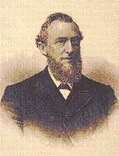
Uriah Smith Daniel & Revelation
Verse 16. "Let seven times pass over him," said the decree. This is plain, literal narration; hence the time is here to be understood literally. How long a period is denoted? This may be determined by ascertaining how long Nebuchadnezzar, in fulfilment of this prediction, was driven out to have his dwelling with the beasts of the field;

Slide 160
Uriah Smith
and this, Josephus informs us, was seven years. A "time," then, denotes one year. When used in symbolic prophecy, it would, of course, denote symbolic or prophetic time. A "time" would then denote a prophetic year, or, each day standing for a year, three hundred and sixty literal years. In Bible chronology thirty days are reckoned to the month, and 360 days to the year.

Slide 161
Uriah Smith
This, my Christian friend, is our crime, for which the church has been and will be punished seven times. "And if ye will not be reformed by me by these things." What does God mean by "these things"? I answer, It is God does the work, and he means his people shall give him the glory;.

Slide 162
Uriah Smith
and when they have passed through the furnace of affliction, and when seven times has passed over them, as it did over Nebuchadnezzar, then will the church, like the proud monarch, learn that God rules in heaven and earth

Slide 163
Daniel 5
And this is the writing that was written, MENE, MENE, TEKEL, UPHARSIN.
(Dan 5:25)

Slide 164
Daniel 5
Each of the words the fingers inscribed on the wall is a measure of weight (like our ounce, pound, and ton, or milligram, gram, and kilogram). The basic Babylonian unit of weight was the gold shekel (tekel in this verse).

Slide 165
Daniel 5
The mena equalled 50 shekels; the upharsin (half a mena) equalled 25. The four words, therefore, stood for: mena, 50 shekels; mena, 50 shekels; tekel, 1 shekel; upharsin, 25 shekels. The total equalled 126 shekels.

Slide 166
2520 in Daniel
In addition, each shekel can be divided into even smaller units (as a pound can be divided into ounces, for example). The shekel was equal to 20 gerahs (Ezekiel 45:12). The 126 shekels of Daniel 5:25 is equivalent to 2,520 gerahs.

Slide 167
2520 in Daniel
So when Daniel saw it he understood it in the lieu of prophecy where the Babylonians could not figure out what 126 meant to them.

Slide 168
2520 in Daniel
Imagine for Daniel, he recognized the 2520 year curse from the law of Moses, yet this at the same time showed him that the prophetic time period was moving on. That the prophecies our Lord had given to him were systematically being fulfilled.

Slide 169
Daniels proclamation
This is the interpretation of the thing: MENE; God hath numbered thy kingdom, and finished it. TEKEL; Thou art weighed in the balances, and art found wanting. PERES; Thy kingdom is divided, and given to the Medes and Persians. (Dan 5:26-28 KJV)

Slide 170
Daniel 9
Yea, all Israel have transgressed thy law, even by departing, that they might not obey thy voice; therefore the curse is poured upon us, and the oath that is written in the law of Moses the servant of God, because we have sinned against him.

Slide 171
Daniel 9
And he hath confirmed his words, which he spake against us, and against our judges that judged us, by bringing upon us a great evil: for under the whole heaven hath not been done as hath been done upon Jerusalem. As it is written in the law of Moses, all this evil is come upon us: yet made we not our prayer before the LORD our God, that we might turn from our iniquities, and understand thy truth. (Dan 9:11-13 KJV)

Slide 172
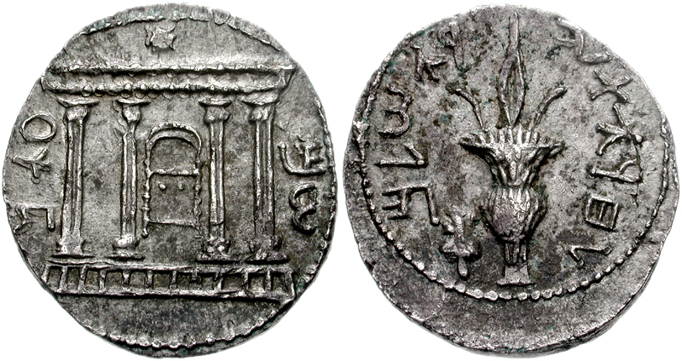
Shekel

Slide 173
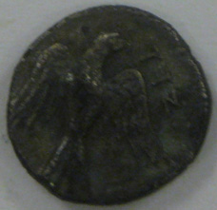
Gerah

Slide 174
Conclusion 2520 Year Prophecy
2008 Prophecy School Ozark

Slide 175
Conclusion
1. The 2520 establishes our understanding of the 2300 year prophecy.
2. That our Lord repeats and enlarges this subject multiple times throughout scripture

Slide 176
Conclusion
3. That we are now in the final phase of the gathering.
4. It confirms our understanding of where we are today in prophecy.
5. That there is no more time.

Slide 177
Daniel 12
And one said to the man clothed in linen, which was upon the waters of the river, How long shall it be to the end of these wonders?(Dan 12:6)

Slide 178
Daniel 12
And I heard the man clothed in linen, which was upon the waters of the river, when he held up his right hand and his left hand unto heaven, and sware by him that liveth for ever that it shall be for a time, times, and an half; and when he shall have accomplished to scatter the power of the holy people, all these things shall be finished.(Dan 12:7)

Slide 179
Scripture
Gen 49:10 The sceptre shall not depart from Judah, nor a lawgiver from between his feet, until Shiloh come; and unto him shall the gathering of the people be.

Slide 180
Scripture
2Th 2:1,2 Now we beseech you, brethren, by the coming of our Lord Jesus Christ, and by our gathering together unto him, That ye be not soon shaken in mind, or be troubled, neither by spirit, nor by word, nor by letter as from us, as that the day of Christ is at hand.

Slide 181
Resource Links
http://books.google.com/books?id=QeSrDhhXPf8C&pg=PA180&lpg=PA180&dq=samaria+722+assyria+siege&source=web&ots=ZtgkF6RqtR&sig=DTDV-jb0jhAfL51Iebuv7J3rfR8&hl=en&sa=X&oi=book_result&resnum=2&ct=result
http://www.ucgstp.org/bible/brp/2ki17a.htm
http://books.google.com/books?id=haVoe4n0ifIC&pg=PA169&lpg=PA169&dq=samaria+722+assyria+siege&source=web&ots=4HjMB1RZ7n&sig=hQBUha_rQpA4pzRlNeWIB2EQmkk&hl=en&sa=X&oi=book_result&resnum=5&ct=result

