Slide 1
Islam in Prophecy
Our Foundation Series

Slide 2
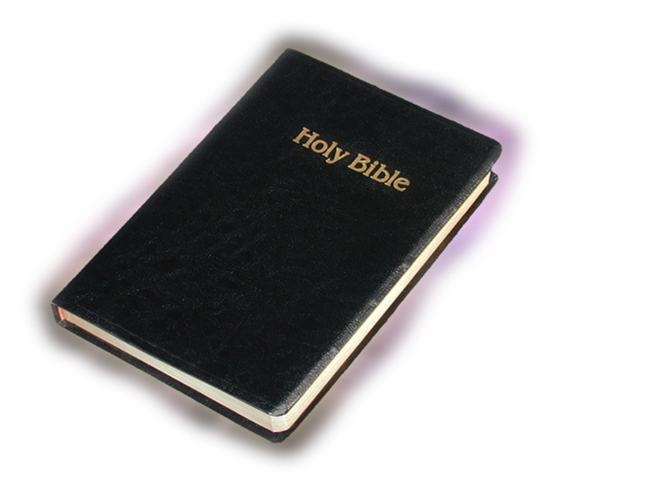
Where to Begin?
And the angel of the LORD said unto her, Behold, thou art with child, and shalt bear a son, and shalt call his name Ishmael; because the LORD hath heard thy affliction. And he will be a wild man; his hand will be against every man, and every man's hand against him; and he shall dwell in the presence of all his brethren. (Gen 16:11-12 KJV)

Slide 3
Curse and Blessing
his hand will be against every man, and every man's hand against him (Gen 16:12 KJV)
H3458 ישׁמעאל yishmâ‛ê'l yish-maw-ale'
From H8085 and H410; God will hear; Jishmael, the name of Abraham’s oldest son, and of five Israelites: - Ishmael.

Slide 4
Islam in Prophecy
Biblical Review

Slide 5
Biblical Review
And as for Ishmael, I have heard thee: Behold, I have blessed him, and will make him fruitful, and will multiply him exceedingly; twelve princes shall he beget, and I will make him a great nation. (Gen 17:20 KJV)

Slide 6
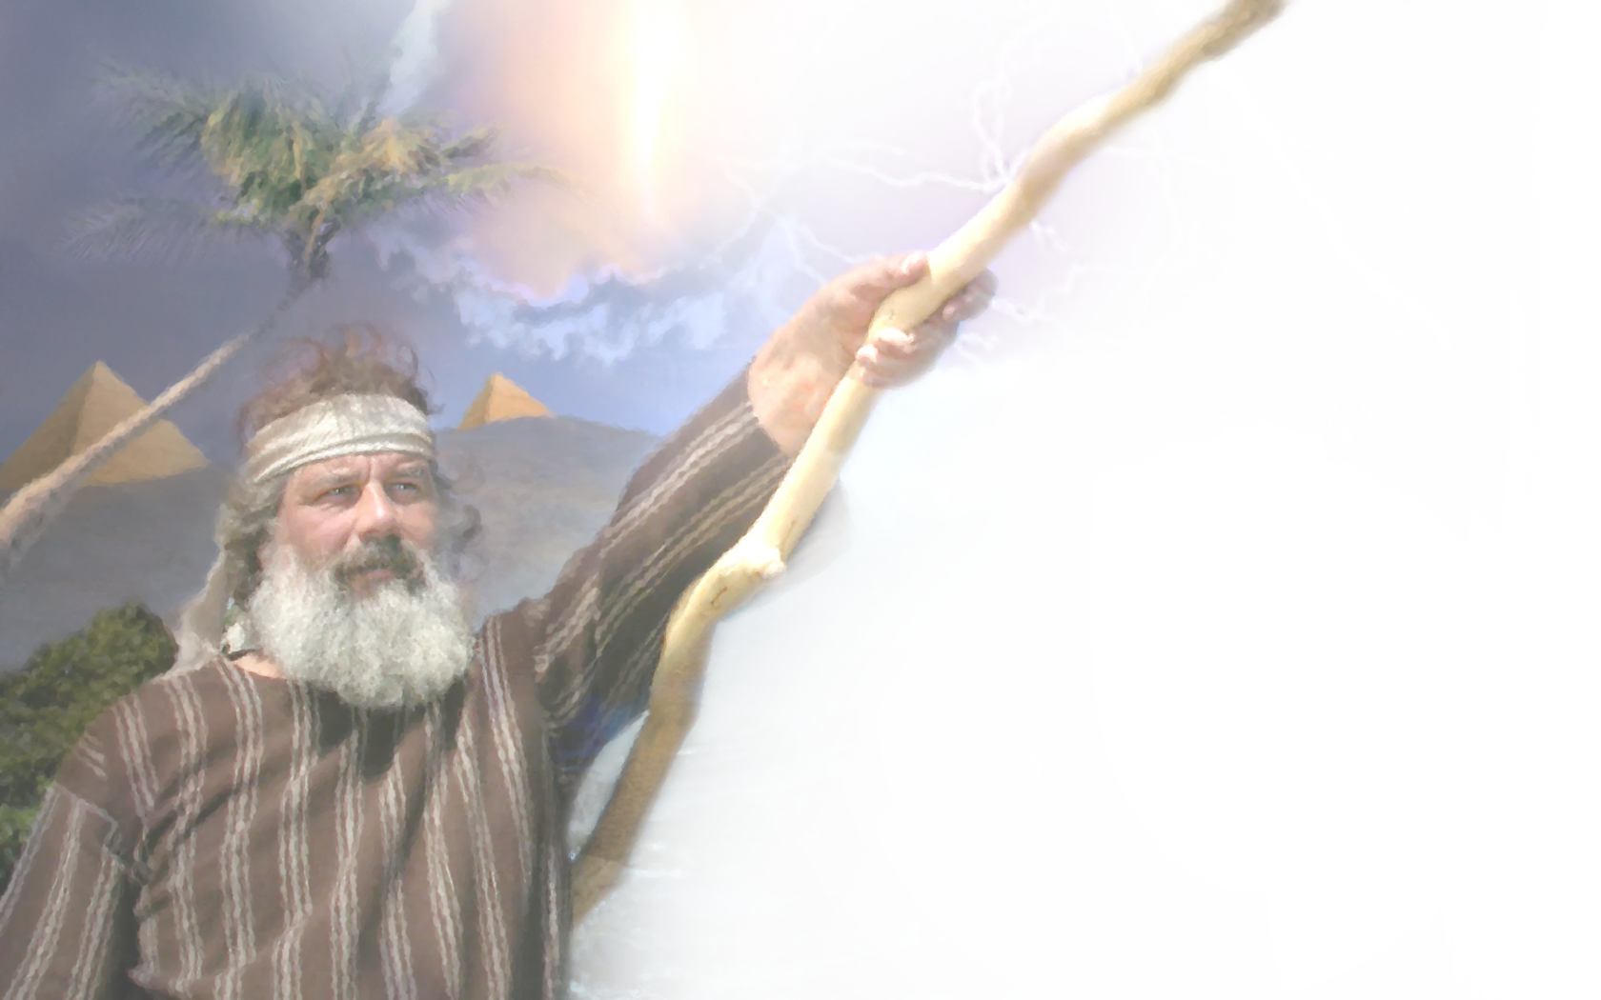
Sons of Ishmael
Now these are the generations of Ishmael, Abraham's son, whom Hagar the Egyptian, Sarah's handmaid, bare unto Abraham: And these are the names of the sons of Ishmael, by their names, according to their generations: the firstborn of Ishmael

Slide 7
Sons of Ishmael
Nebajoth; and Kedar, and Adbeel, and Mibsam, And Mishma, and Dumah, and Massa, Hadar, and Tema, Jetur, Naphish, and Kedemah: These are the sons of Ishmael, and these are their names, by their towns, and by their castles; twelve princes according to their nations. (Gen 25:12-16 KJV)

Slide 8
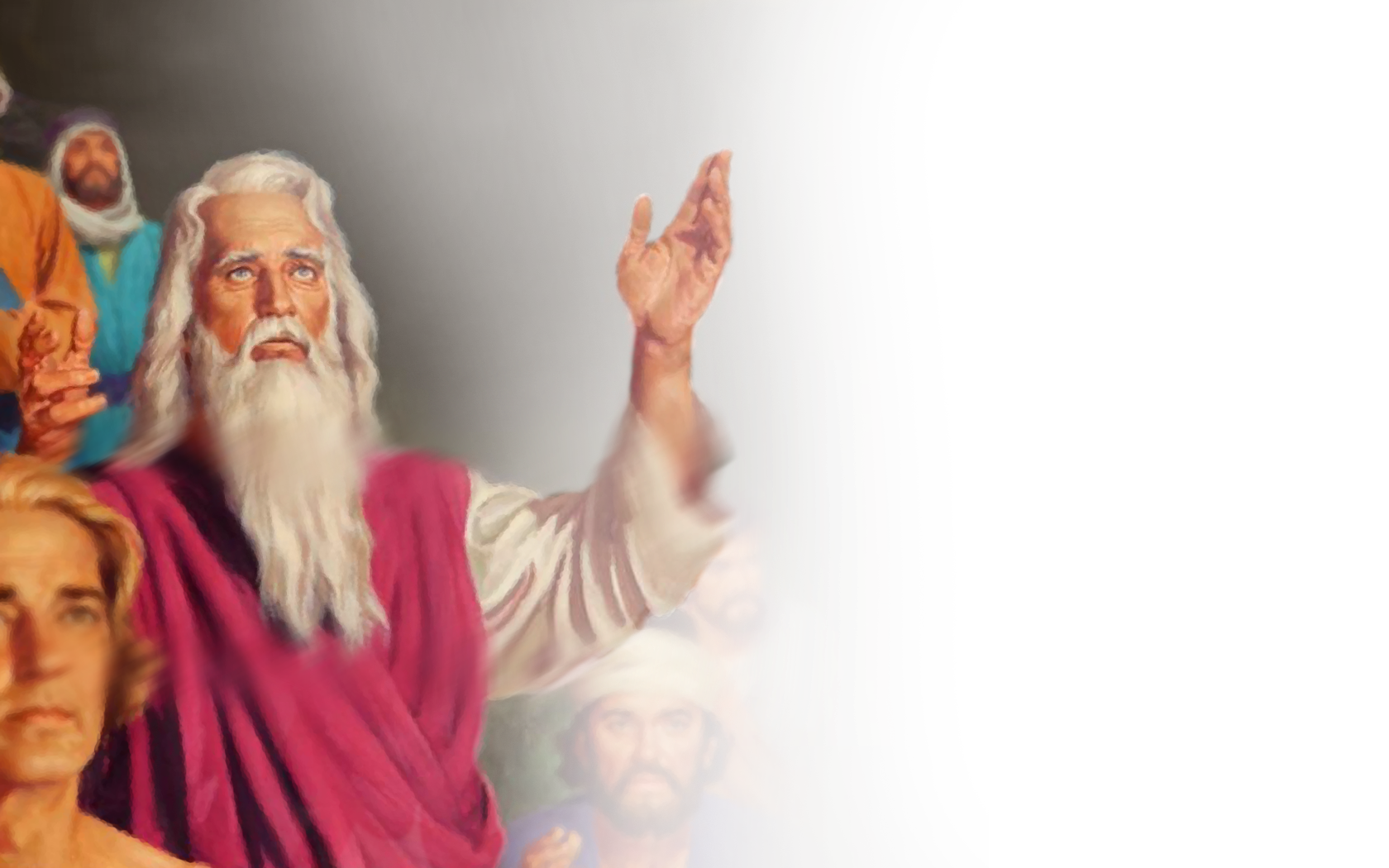
Sons of Israel
The sons of Leah; Reuben, Jacob's firstborn, and Simeon, and Levi, and Judah, and Issachar, and Zebulun: The sons of Rachel; Joseph, and Benjamin

Slide 9
Sons of Israel
And the sons of Bilhah, Rachel's handmaid; Dan, and Naphtali: And the sons of Zilpah, Leah's handmaid; Gad, and Asher: these are the sons of Jacob, which were born to him in Padanaram. (Gen 35:23-26 KJV)

Slide 10
Islam in Prophecy
Blessing

Slide 11
Rescue of Joseph
Then there passed by Midianites merchantmen; and they drew and lifted up Joseph out of the pit, and sold Joseph to the Ishmeelites for twenty pieces of silver: and they brought Joseph into Egypt. (Gen 37:28 KJV)

Slide 12
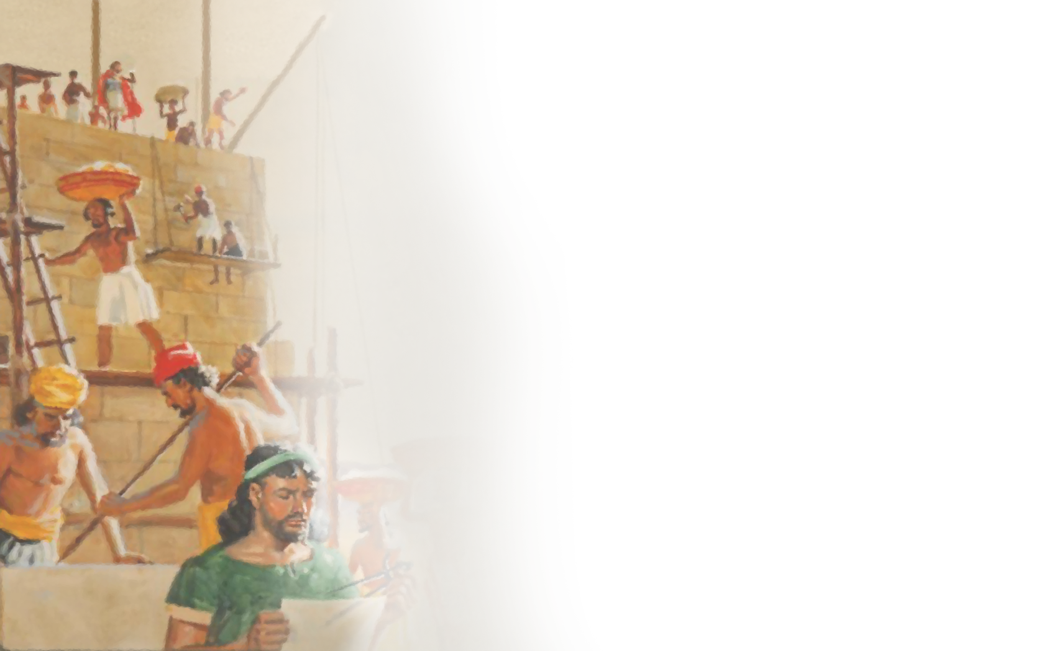
Moses & Midian
Now when Pharaoh heard this thing, he sought to slay Moses. But Moses fled from the face of Pharaoh, and dwelt in the land of Midian: and he sat down by a well. Now the priest of Midian had seven daughters: and they came and drew water, and filled the troughs to water their father's flock. (Exo 2:15-16 KJV)

Slide 13
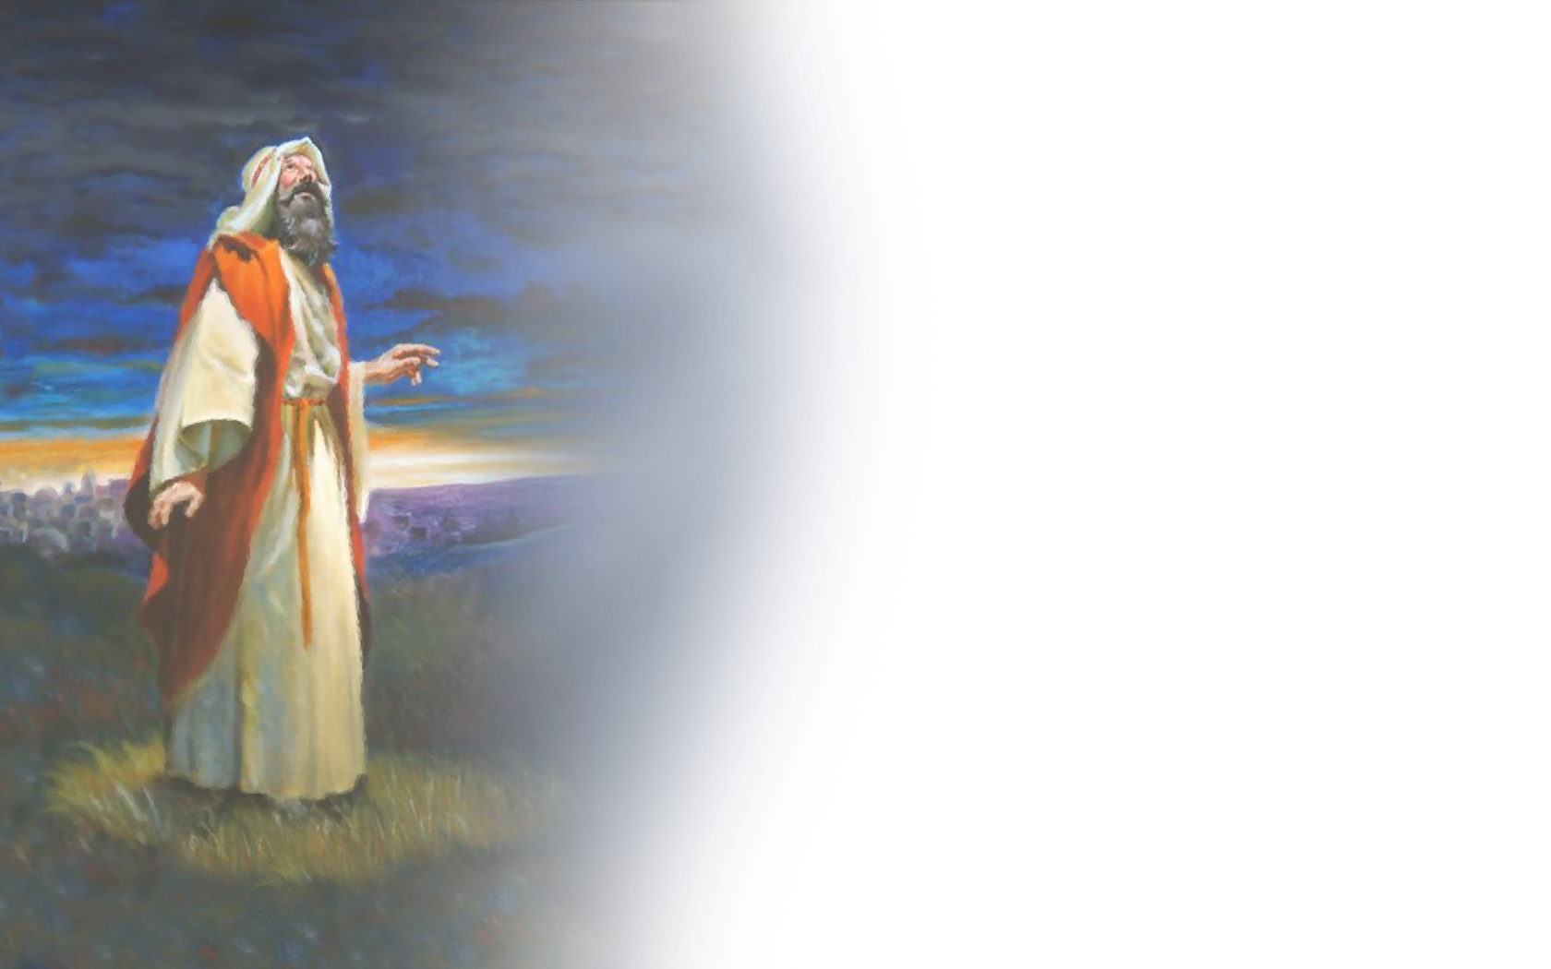
Interaction Sanctuary Service
And Aaron shall burn thereon sweet incense every morning: when he dresseth the lamps, he shall burn incense upon it. (Exo 30:7 KJV)
The multitude of camels shall cover thee, the dromedaries of Midian and Ephah; all they from Sheba shall come: they shall bring gold and incense; and they shall shew forth the praises of the LORD.(Isa 60:6 KJV)

Slide 14
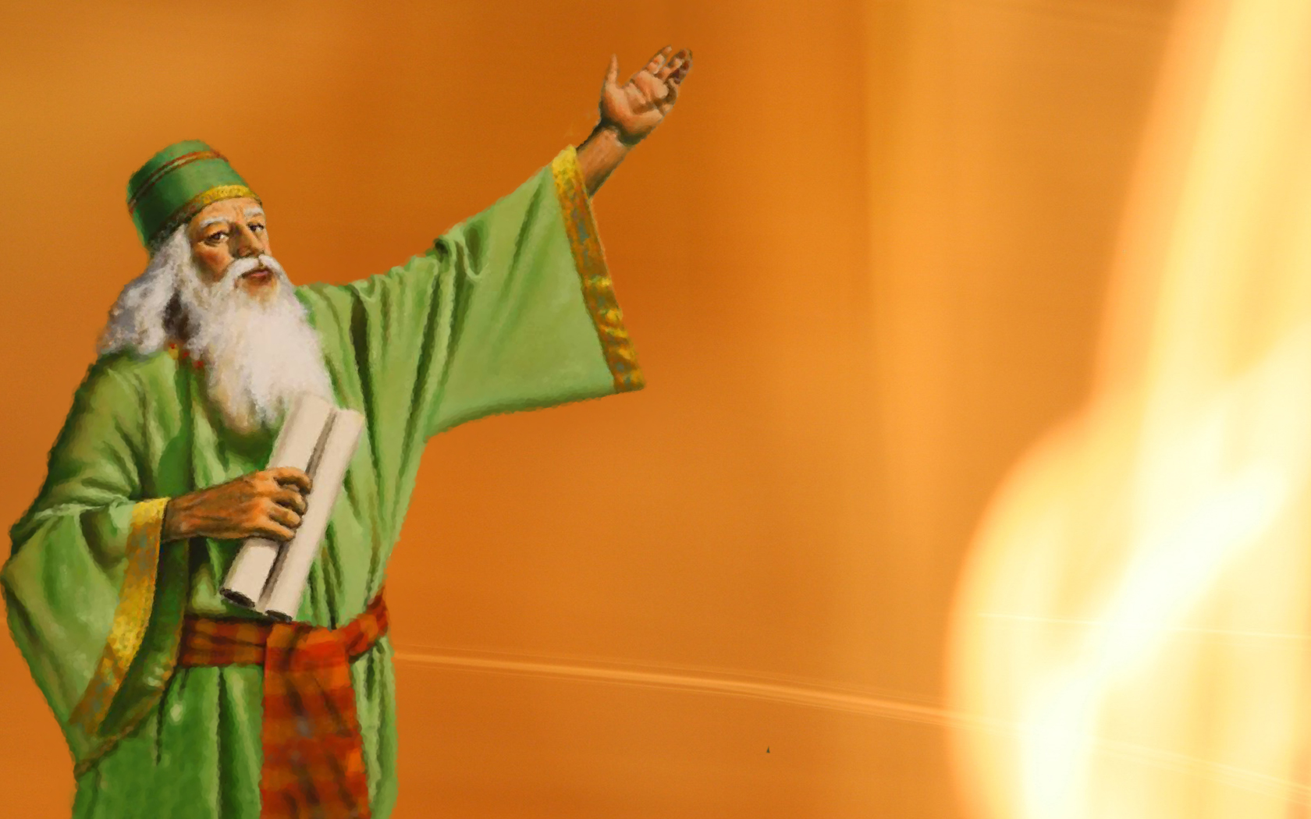
Prophet
And the elders of Moab and the elders of Midian departed with the rewards of divination in their hand; and they came unto Balaam, and spake unto him the words of Balak. (Num 22:7 KJV)
And God said unto Balaam, Thou shalt not go with them; thou shalt not curse the people: for they are blessed. (Num 22:12 KJV)

Slide 15
In Daniel
He shall enter also into the glorious land, and many countries shall be overthrown: but these shall escape out of his hand, even Edom, and Moab, and the chief of the children of Ammon. (Dan 11:41 KJV)
Notes:
Children of Edom are from Esau, the children of Moab and Ammon are from Lot and they with the Children of Ishmael are the Children of Islam. Today they are all the Children of Islam

Slide 16
Islam in Prophecy
7 Trumpets & 3 Woes

Slide 17
7 Trumpets Timeline
321 330 395 428 433 476 538 627 1299 1449 1840 1842
321 The first Sunday Law
330 Constantine moves his Capitol from Rome to Constantinople
395 Aleric arrives (1st Trumpet)
428 Genseric arrives (2nd Trumpet)
433 Attila the Hun arrives (3rd Trumpet)
476 Odoacer brings final demise to Western Rome (4th Trumpet)
538 Papal Rome begins to rule
627 December 27th the Battle of Nineveh opens the way for Islam(5th Trumpet)
1299 Ottoman Empire established (1st Woe)
1449 1st Woe & 5th Trumpet Conclude (Constantine) (2nd Woe 6th Trumpet begin)
1840 August 11th (2nd Woe concludes 6th Trumpet)
1842 Protestants close the door to the 2520 Year Prophecy

Slide 18
Revelation 8:7-12
The first angel sounded, and there followed hail and fire mingled with blood, and they were cast upon the earth: and the third part of trees was burnt up, and all green grass was burnt up.
: and the third part of the sea became blood; And the third part of the creatures which were in the sea, and had life, died; and the third part of the ships were destroyed.
And the third angel sounded, and there fell a great star from heaven, burning as it were a lamp, and it fell upon the third part of the rivers, and upon the fountains of waters; And the name of the star is called Wormwood: and the third part of the waters became wormwood; and many men died of the waters, because they were made bitter.
And the fourth angel sounded, and the third part of the sun was smitten, and the third part of the moon, and the third part of the stars; so as the third part of them was darkened, and the day shone not for a third part of it, and the night likewise. (Rev 8:7-12 KJV)
Alaric arrives in 395, and in 410 the city of Rome was taken. (First Trumpet) Scorched Earth Policy.
Genseric, 428-468 (Second Trumpet) Sacked Rome in 455 AD, Naval warfare was his focus and defeated Western Rome on the seas.
Attila the Hun from 433 to 453.(Third Trumpet) Attack was swift & violent over the Alps, and his Battles took place by Rivers, died shortly after taking Rome, in a drunken state in 453 when Rome was his and on the day of his marriage of a nosebleed.
Odoacer conquered by politics and war brought the final demise of western Rome in 476-493 (Fourth Trumpet) Ruled Rome by using their own system of government. Emperor the Sun abolished/ Judicial system the Moon / Senate the stars.

Slide 19
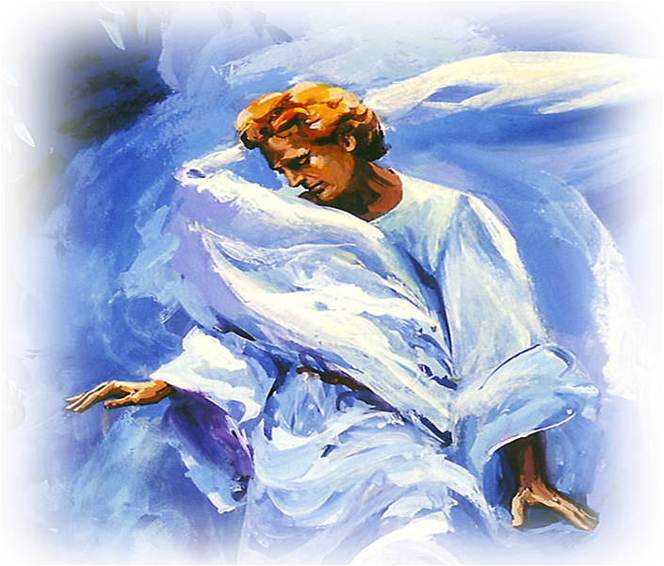
3 Woe’s Last 3 Trumpets
And I beheld, and heard an angel flying through the midst of heaven, saying with a loud voice, Woe, woe, woe, to the inhabiters of the earth by reason of the other voices of the trumpet of the three angels, which are yet to sound! (Rev 8:13 KJV)

Slide 20
Time Line Woe’s
538 570 623? 632 1299 1449 1798 1840 1842 1844
538 Papal Rome begins to establish its power Goths removed
570 Muhammad is born (ca. 570 Mecca – June 8, 632 Medina)
623 Chosroe II and Muhammad (Revelation 9:1)
632 Abu-Bekr’s decree against Papal Rome 5th Trumpet
1299 1st Woe July 27th Battle of Nicomedia 9:10
1449 6th Trumpet 2nd Woe Supremacy of Ottoman Empire 9:15
1798 Deadly Wound fulfillment of Daniel 12
1840 Fulfillment of Rev 9:15 August 11th Josiah Litch
1842 Protestant Churches reject the 2520 Close the doors
1844 7th Trumpet begins to sound Oct 22nd Christ enters….
Notes:
When a trumpet blows prophetically does it stop blowing? If so when does it

Slide 21
Trumpets, Woes - Revelation 9 & 10
بسم الله الرحمن الرحيم
من محمد رسول الله الى كسرى عظيم الفارس . سلام على من اتبع الهدى و آمن بالله و رسوله و شهد ان لااله الا الله وحده لاشريك له و ان محمد عبده و رسوله. ادعوك بدعاء الله، فانى رسول الله الى الناس كافة لانذر من كان حيا و يحق القول على الكافرين. فاسلم تسلم . فان ابيت فان اثم المجوس عليك .
English translation:
In the name of Allah, Most Gracious, Ever Merciful
From Muhammad, Messenger of Allah, to Chosroes, Ruler of Persia. Peace be on him who follows the guidance, believes in Allah and His Messenger and bears witness that there is no one worthy of worship save Allah, the One, without associate, and that Muhammad is His Servant and Messenger. I invite you to the Call of Allah, as I am the Messenger of Allah to the whole of mankind, so that I may warn every living person and so that the truth may become clear and the judgment of God may overtake the infidels. I call upon you to accept Islam and thus make yourself secure. If you turn away, you will bear the sins of your Zoroastrian subjects.
And the fifth angel sounded, and I saw a star fall from heaven unto the earth: and to him was given the key of the bottomless pit. And he opened the bottomless pit; and there arose a smoke out of the pit, as the smoke of a great furnace; and the sun and the air were darkened by reason of the smoke of the pit. (Rev 9:1-2 KJV)
Abdullah told Muhammad how Khusraw had torn his letter to pieces and Muhammad's only reply was, "May his kingdom tear apart".

Slide 22
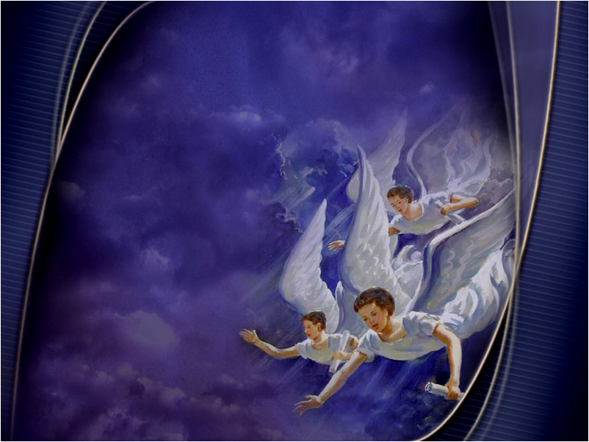
Revelation 14:7
Saying with a loud voice, Fear God, and give glory to him; for the hour of his judgment is come: and worship him that made heaven, and earth, and the sea, and the fountains of waters. (Rev 14:7)

Slide 23

Trumpets, Woes – Revelation 9 & 10 Saracens
And there came out of the smoke locusts upon the earth: and unto them was given power, as the scorpions of the earth have power. And it was commanded them that they should not hurt the grass of the earth, neither any green thing, neither any tree; but only those men which have not the seal of God in their foreheads. (Rev 9:3-4 KJV)

Slide 24
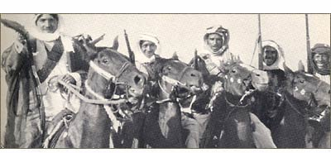
“When you fight the battles of the Lord, acquit yourselves like men, without turning your backs; but let not your victory be stained with the blood of women or children. Destroy no palm-trees, nor burn any fields of corn. Cut down no fruit trees, nor do any mischief to cattle, only such as you kill to eat. When you make any covenant, or article, stand to it, and be as good as your word. As you go on, you will find some religious persons who live retired in monasteries, and propose to themselves to serve God that way;
let them alone, and neither kill them nor destroy their monasteries: and you will find another sort of people that belong to the synagogue of Satan, who have shaven crown; be sure you cleave their skulls and give them no quarter till they either turn Mahometans or pay tribute:” Abu-bekr 632
And it was commanded them that they should not hurt the grass of the earth, neither any green thing, neither any tree; but only those men which have not the seal of God in their foreheads. (Rev 9:4 KJV)
Notes:
Rev 9:4

Slide 25
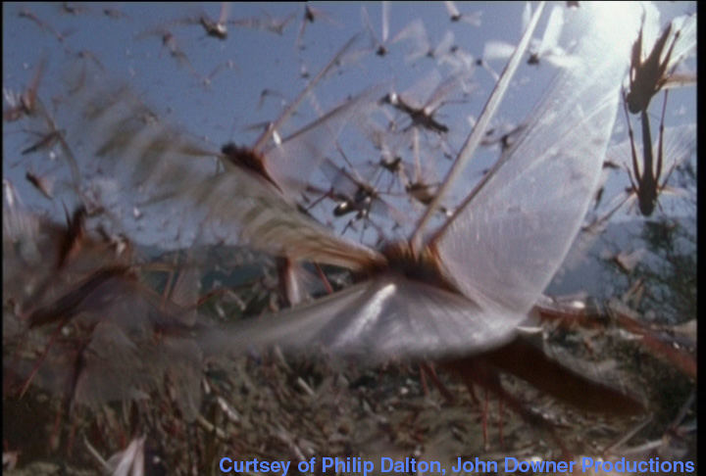
Revelation 9:6-10
And in those days shall men seek death, and shall not find it; and shall desire to die, and death shall flee from them. And the shapes of the locusts were like unto horses prepared unto battle; and on their heads were as it were crowns like gold, and their faces were as the faces of men

Slide 26
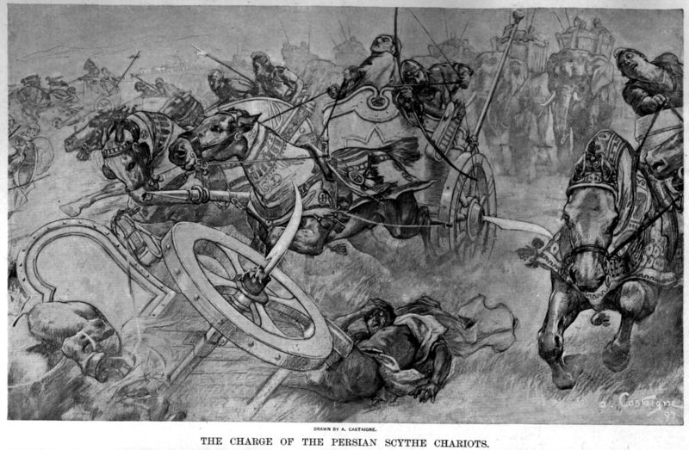
Scripture Text
And they had hair as the hair of women, and their teeth were as the teeth of lions. And they had breastplates, as it were breastplates of iron; and the sound of their wings was as the sound of chariots of many horses running to battle. And they had tails like unto scorpions, and there were stings in their tails: and their power was to hurt men five months. (Rev 9:6-10 KJV)

Slide 27
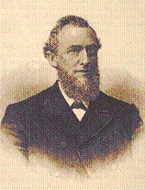
Uriah Smith
But when did Othman make his first assault on the Greek empire? – According to Gibbon “it was on the twenty-seventh of July, in the year twelve hundred and ninety-nine of the Christian Era, that Othman first invaded the territory of Nicomedia; and the singular accuracy of the date seems to disclose some foresight of the rapid and destructive growth of the monster”. Pg 503 D & R

Slide 28
Uriah Smith
‘Five Month’ [thirty days to a month, one hundred and fifty day], that is, on hundred and fifty years. Commencing July 27^{th,} 1299, the 150 years reach to 1449.

Slide 29
Uriah Smith
During that whole period the Turks were engaged in an almost perpetual war with the Greek Empire, but yet without conquering it. -- But in 1449, the termination of the 150 years, a change came, the history of which will be found under the succeeding trumpet.

Slide 30
Revelation 9:12-15
One woe is past; and, behold, there come two woes more hereafter. And the sixth angel sounded, and I heard a voice from the four horns of the golden altar which is before God, Saying to the sixth angel which had the trumpet, Loose the four angels which are bound in the great river Euphrates.

Slide 31
Revelation 9:12-15
And the four angels were loosed, which were prepared for an hour, and a day, and a month, and a year, for to slay the third part of men. (Rev 9:12-15 KJV)

Slide 32
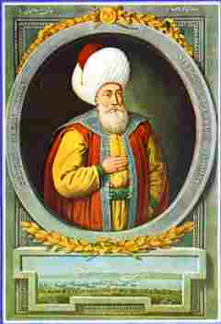
Four Angels
These are the four principal sultanies of which the Ottoman Empire was composed, located in the country watered by the Euphrates. These sultanies were situated at Aleppo, Iconium, Damascus, and Bagdad. Previously they had been restrained; but God commanded and they were loosed. {Pg 506 D&R)

Slide 33
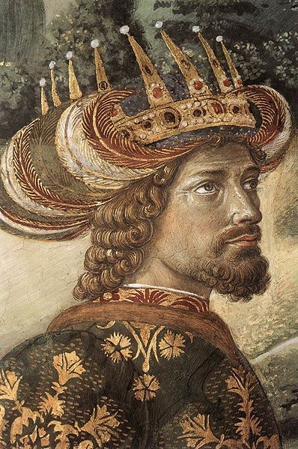
Uriah Smith
Late in the year 1448, as the close of the 150 year period approached, John Paleologus died without leaving a son to follow him on the throne of the Eastern Empire. His brother Constantine, the lawful successor, would not venture to ascend the throne without the consent of the Turkish Sultan.
Notes:
If you ask someone else to do something that is yours to have, are you not saying then it is not yours to keep?

Slide 34
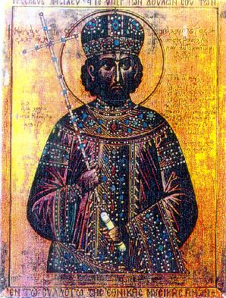
Uriah Smith
Early in the years 1449, under these ominous circumstances, Constantine, the last of the Greek Emperors, was crowned. {Pg 506 DR}
Notes:
If you ask someone else to do something that is yours to have, are you not saying then it is not yours to keep?

Slide 35
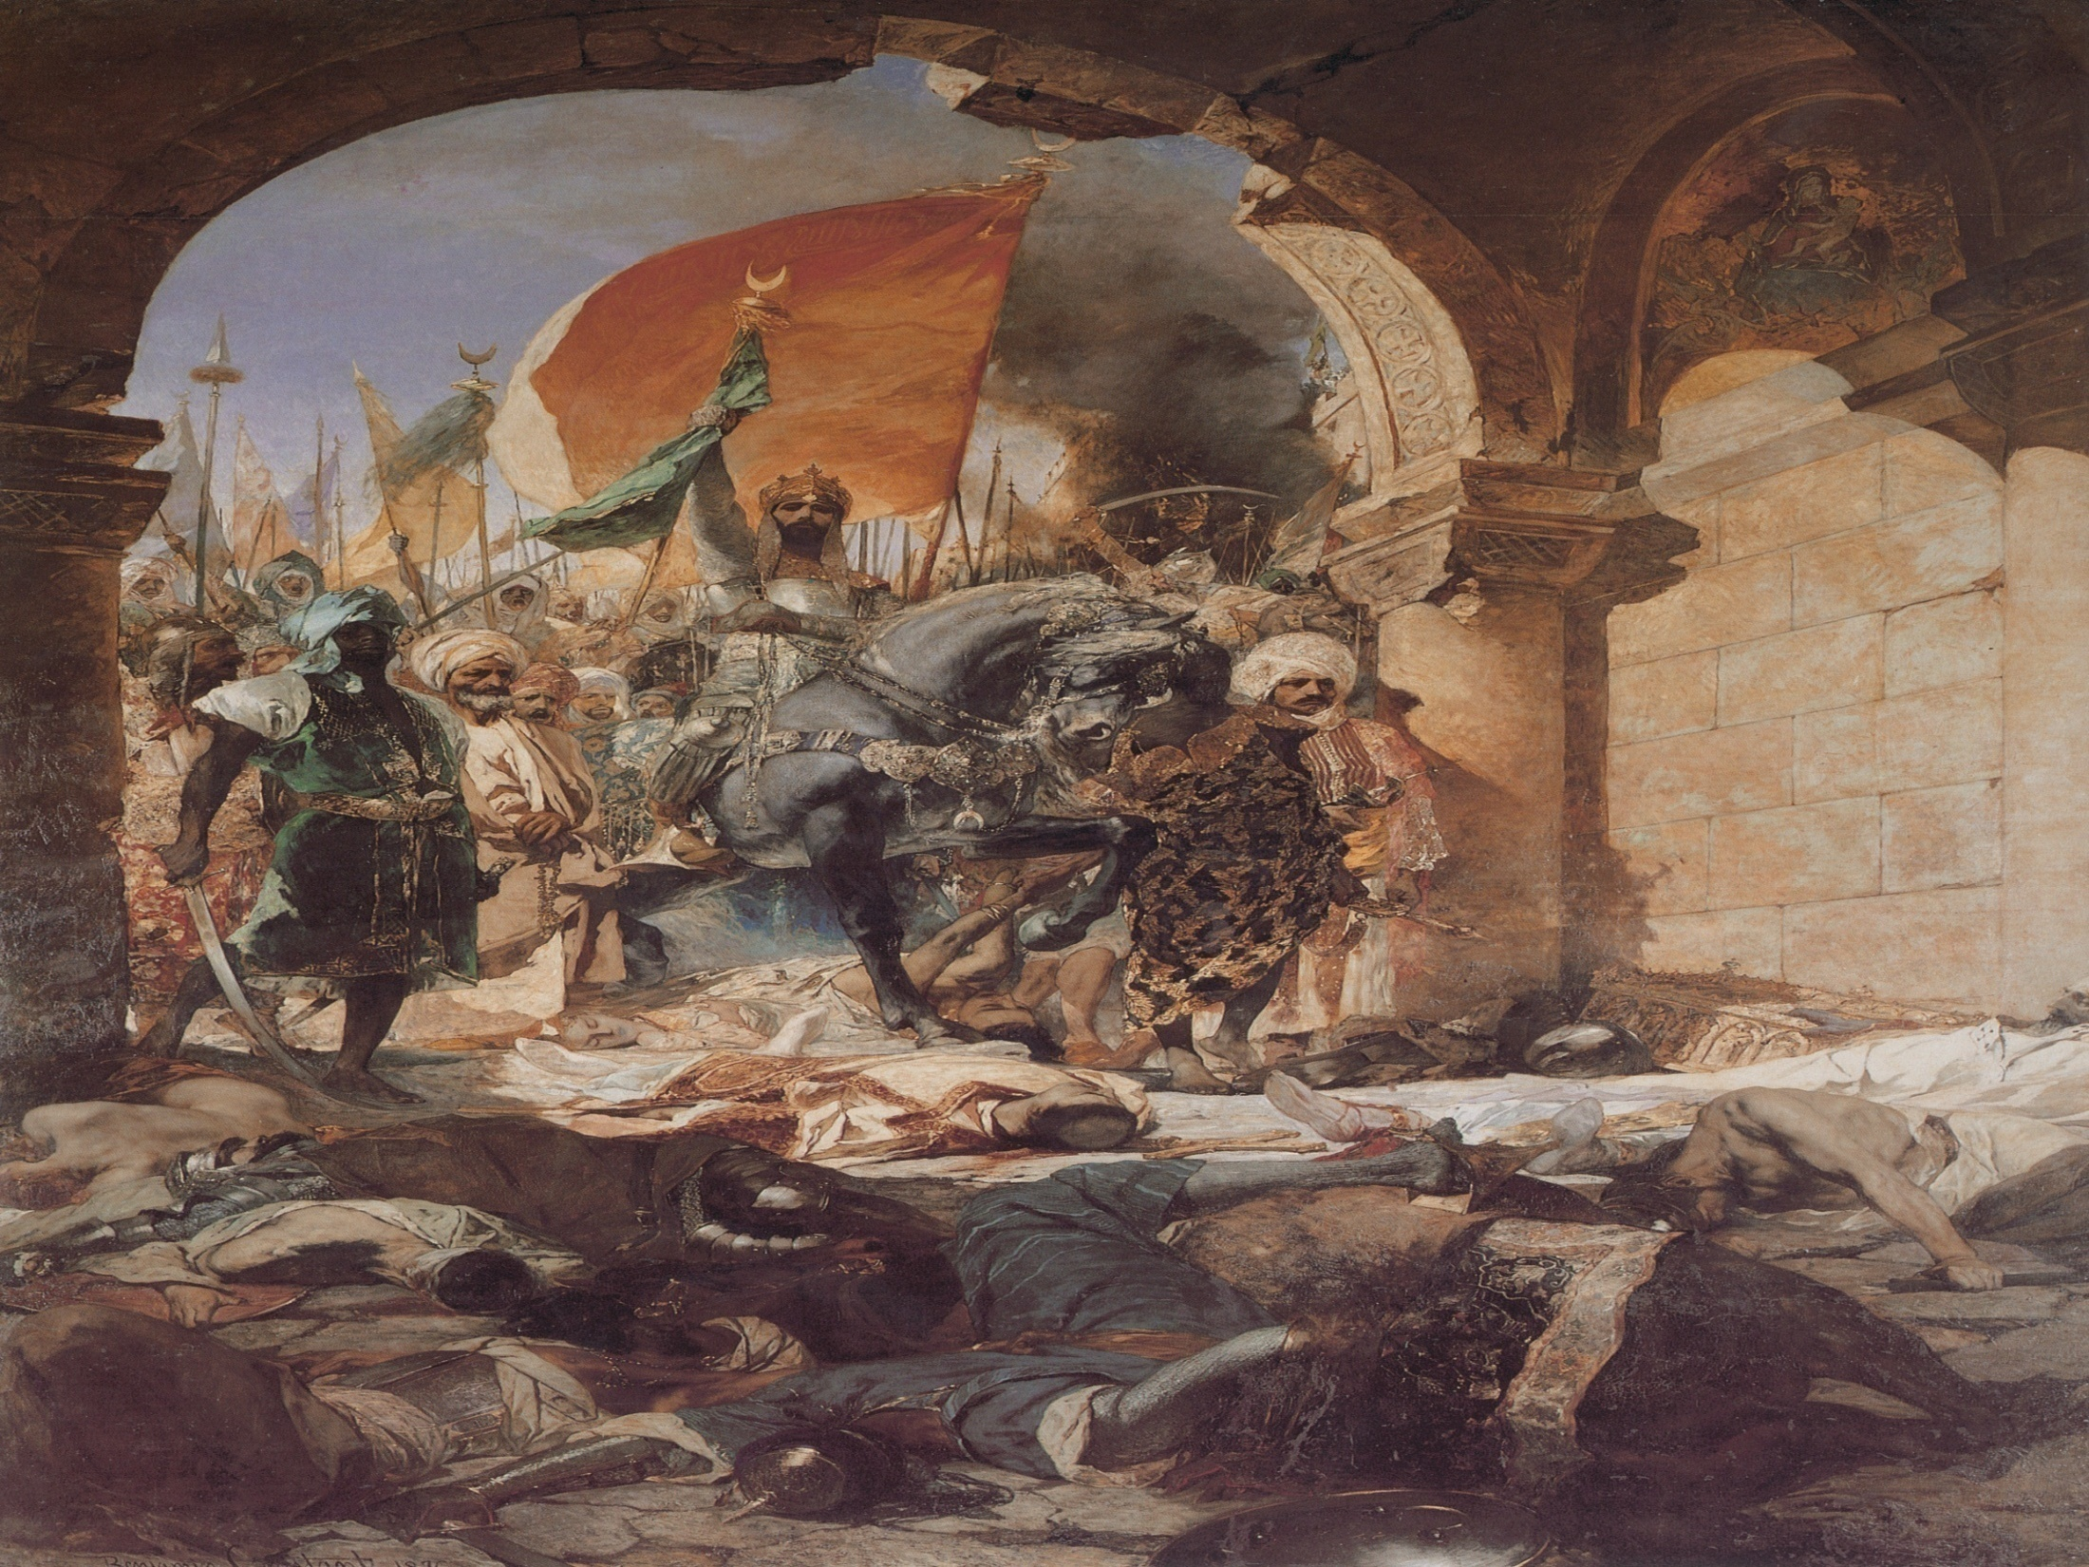
Uriah Smith
Amurath, the sultan to whom the submission of Deacozes was made, and by whose permission he reigned in Constantinople, soon after died, and was succeeded in the empire, in 1451, by Mahomet II, who set his heart on Constantinople, and determined to make it prey. – The siege commenced on the 6th of April, 1453, and ended in the taking of the city , and death of the last of the Constantines, on 16th day of May following. {Pg 507 D&R}

Slide 36
391 Years & 15 Days
And the four angels were loosed, which were prepared for an hour, and a day, and a month, and a year, for to slay the third part of men. (Rev 9:15 KJV)

Slide 37
Islam in Prophecy
God Does Not Change & History Repeats

Slide 38
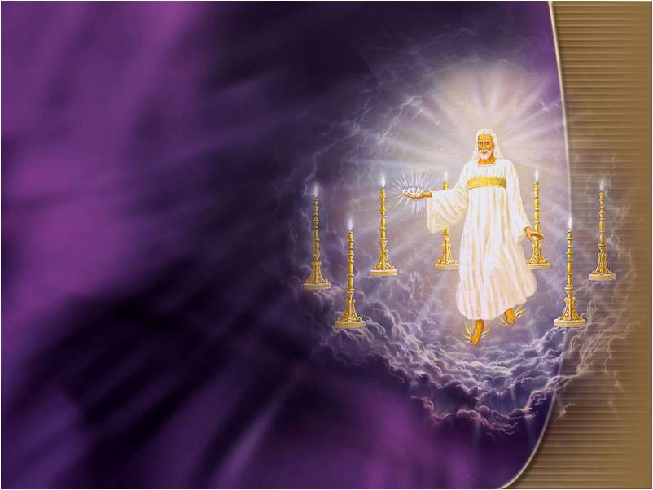
God does not Change
For I am the LORD, I change not; therefore ye sons of Jacob are not consumed. (Mal 3:6 KJV)

Slide 39
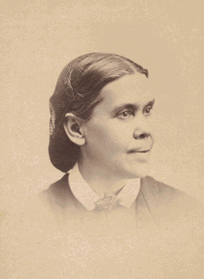
Sacred History
In those schools of the olden time it was the grand object of all study to learn the will of God, and man's duty toward him. In the records of sacred history were traced the footsteps of Jehovah. The great truths set forth by the types were brought to view, and faith grasped the central object of all that system,--the Lamb of God that was to take away the sin of the world. {CE 62.1}

Slide 40
History Repeats
History repeats itself. The same masterful mind that plotted against the faithful in ages past is now at work to gain control of the Protestant churches, that through them he may condemn and put to death all who will not worship the idol sabbath.

Slide 41
History Repeats
History repeats itself.:We have not to battle with man, as it may appear. We wrestle not against flesh and blood, but against principalities, against powers, against the rulers of the darkness of this world, against spiritual wickedness in high places.

Slide 42
History Repeats
History repeats itself. But if the people of God will put their trust in Him, and by faith rely upon His power, the devices of Satan will be defeated in our time as signally as in the days of Mordecai. {ST, November 8, 1899 par. 10}

Slide 43
Scripture
That which hath been is now; and that which is to be hath already been; and God requireth that which is past. (Ecc 3:15 KJV)

Slide 44
History is Repeating
In mercy God repeats his past dealings. He has given us a record of his dealings in the past. This we need to study carefully; for history is repeating itself. We are more accountable than were those whose experience is recorded in the Old Testament; for their mistakes, and the results of those mistakes, have been chronicled for our benefit.

Slide 45
History is Repeating
The danger-signal has been lifted to keep us off forbidden ground, and we should be warned not to do as they did, lest a worse punishment come upon us. The blessings given to those of past generations who obeyed God are recorded that we may be encouraged to walk circumspectly, in faith and obedience.

Slide 46
History is Repeating
The judgments brought against wrong-doers are delineated that we may fear and tremble before God. This Scripture biography is a great blessing. This precious instruction, the experience of ages, is bequeathed to us. {RH, April 20, 1897 par. 14}

Slide 47
Seek Again
But God "seeks again that which is past" recalling all the proceedings whether of judgment or of mercy. He recalls all the doings of different ages and repeats them in the present generation. It is for this reason that there is such value in the registered experience of the believers of other days.

Slide 48
Seek Again
The biography of the righteous is among the best treasures that the church can possess. We have the benefit of the accounts of the workings of the power of evil in contrast to the deeds of those who through many centuries were living by every word that proceedeth out of the mouth of God. This rich experience is bequeathed to us as a legacy of great value.

Slide 49
Seek Again
When history shall be repeated, when the great men of earth will not come to the Bible for light and evidence and truth, when the commandments of men shall be exalted above the commandments of God, --

Slide 50
Seek Again
-- And when it shall be regarded a crime to obey God rather than the laws of men, then we shall not have to tread a path in which we have had but few examples of others who have gone before us. {9MR 275.1}

Slide 51
What has happened?
And the vision of all is become unto you as the words of a book that is sealed, which men deliver to one that is learned, saying, Read this, I pray thee: and he saith, I cannot; for it is sealed: And the book is delivered to him that is not learned, saying, Read this, I pray thee: and he saith, I am not learned. (Isa 29:11-12 KJV)
Notes:
The word vision also means prophecy, our understanding of the prophetic word has been closed or sealed to us. It is prophecy that becomes unsealed in the last days that opens our eyes and understanding of God.

Slide 52
Warning & Blessing
It was not the leaders in the church who had an understanding of this truth, and engaged in its proclamation. Had these been faithful watchmen, diligently and prayerfully searching the Scriptures, they would have known the time of night; the prophecies would have opened to them the events about to take place.

Slide 53
Warning & Blessing
But they did not occupy this position, and the message was given by another class. Said Jesus, "Walk while ye have the light, lest darkness come upon you." [JOHN 12:35.] Those who turn away from the light which God has given, or who neglect to seek it when it is within their reach, are left in darkness.

Slide 54
Warning & Blessing
But the Saviour declares, "He that followeth me shall not walk in darkness, but shall have the light of life." [JOHN 8:12.] Whoever is with singleness of purpose seeking to do God's will, earnestly heeding the light already given, will receive greater light; to that soul some star of heavenly radiance will be sent, to guide him into all truth. {GC88 312.1}

Slide 55
Islam in Prophecy
Revelation 9:15 Fulfilled

Slide 56
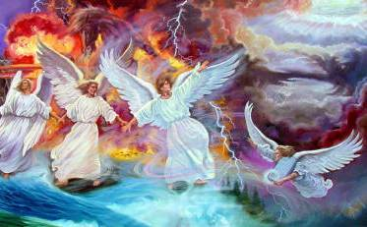
391 Years & 15 Days
And the four angels were loosed, which were prepared for an hour, and a day, and a month, and a year, for to slay the third part of men. (Rev 9:15 KJV)

Slide 57
391 Years 15 Days
1 Hour = 15 Days
1 day = 1 Year
1 month = 30 Days = 30 years
1 year = 360 Days = 360 years
360
30
1.15
Total 391 years and 15 days

Slide 58
Uriah Smith
Late in the year 1448, as the close of the 150 year period approached, John Paleologus died without leaving a son to follow him on the throne of the Eastern Empire.
Notes:
If you ask someone else to do something that is yours to have, are you not saying then it is not yours to keep?

Slide 59
Uriah Smith
His brother Constantine, the lawful successor, would not venture to ascend the throne without the consent of the Turkish Sultan. Early in the years 1449, under these ominous circumstances, Constantine, the last of the Greek Emperors, was crowned. {Pg 506 DR}
Notes:
If you ask someone else to do something that is yours to have, are you not saying then it is not yours to keep?

Slide 60
Four Angels
These are the four principal sultanies of which the Ottoman Empire was composed, located in the country watered by the Euphrates. These sultanies were situated at Aleppo, Iconium, Damascus, and Bagdad. Previously they had been restrained; but God commanded and they were loosed. {Pg 506 D&R)

Slide 61
Four Angels Restrained
In 1838 there was a threatening of war between the sultan and his Egyptian vassal had he not be restrained by the influence of the foreign ambassadors… In 1839 hostilities were again commenced, and were prosecuted until, in a general battle between the armies of the sultan and Mehemet, the sultan’s army was entirely cut up and destroyed, and his fleet taken by Mehemet and carried into Egypt. {Pg 513 D&R}

Slide 62
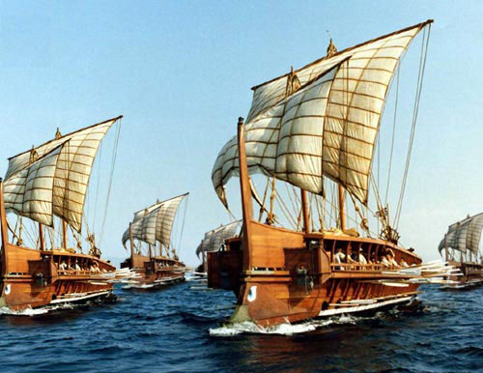
Four Angels Restrained
So completely had the sultan’s fleet been reduced, that, when hostilities commenced in August, he had only two first-rates and three frigates as the sad remains of the once powerful Turkish fleet. This Fleet Mehemet positively refused to give up and return to the sultan, and declared if the powers attempted to take it from him, he would burn it. {pg 513 D&R}

Slide 63
Four Angels Restrained
In this posture affairs stood, when, in 1840, England, Russia, Austria, and Prussia interposed, and determined on a settlement of the difficulty; for it was evident if let alone, Mehemet would soon become master of the sultan’s throne. The sultan accepted this intervention of the great powers and thus made a voluntary surrender of the question into their hands.{Pgs 513-4 D&R}

Slide 64

The Ultimatum
An agreement was drawn up to be presented to the pasha of Egypt, whereby the sultan was to offer him the hereditary government of Egypt, and all the part of Syria extending from the Gulf of Suez to the Lake of Tiberias, together with the province of Acre, for life; he on his part to evacuate all other parts of the sultan’s dominions then occupied by him, and to return the Ottoman fleet. {Pg 514 D&R}

Slide 65
The Fulfillment of Prophecy
The sultan dispatched Rifat Bey on a government steamer to Alexandria, to communicate the ultimatum to Mehemet Ali. The ultimatum was placed at his disposal on the eleventh day of August,1840.

Slide 66
EGW & Josiah Litch
In the year 1840, another remarkable fulfillment of prophecy excited widespread interest. Two years before, Josiah Litch, one of the leading ministers preaching the second advent,

Slide 67
EGW & Josiah Litch
published an exposition of Revelation 9, predicting the fall of the Ottoman empire, and specifying not only the year but the very day on which this would take place.

Slide 68
EGW & Josiah Litch
According to this exposition, which was purely a matter of calculation on the prophetic periods of Scripture, the Turkish government would surrender its independence on the eleventh day of August, 1840. The prediction was widely published, and thousands watched the course of events with eager interest.

Slide 69
EGW & Josiah Litch
At the very time specified, Turkey, through her ambassadors, accepted the protection of the allied powers of Europe, and thus placed herself under the control of Christian nations. The event exactly fulfilled the prediction. {GC88 334.4,5}
And the four angels were loosed, which were prepared for an hour, and a day, and a month, and a year, for to slay the third part of men. (Rev 9:15)

Slide 70
Islam in Prophecy
Next Foundation 3 Angels Message

